Slide 1
Where did modern nursing first begin?
By evie jaszynski

Slide 2
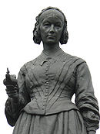
The pioneers
Famous nurses throughout history
Florence Nightingale and Mary Seacole are nurses that changed history.
The medical profession is vital as doctors, nurses and other medical staff help us to all stay healthy and fit, and pioneers like Florence and Mary remind us why services like the NHS are so important.
May 12 markED 200 years since the birth of Florence Nightingale.

Slide 3
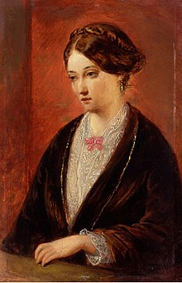
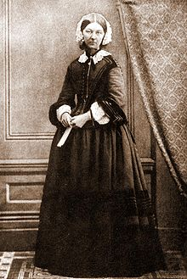
Florence nightingale
1820 -1910
Florence Nightingale was born on 12 May 1820. She was named after the Italian city she was born in, but grew up in England and came from a well-off family. Her father, who was called William, was a wealthy landowner. Like other girls with backgrounds similar to her own, Florence was expected to marry into a suitable family and have children when she reached adulthood, but she had other plans. Florence was interested in education and learning from a very young age and was inspired to do more with her life.

Slide 4
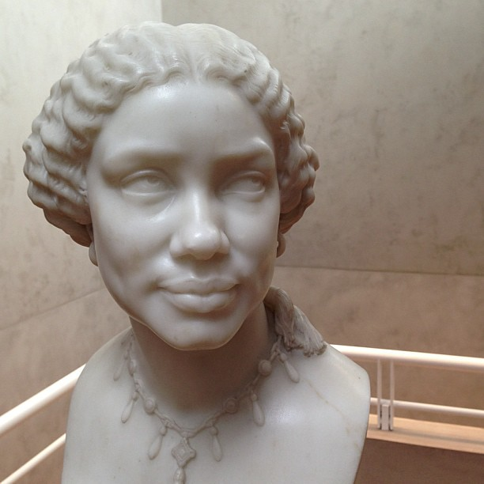
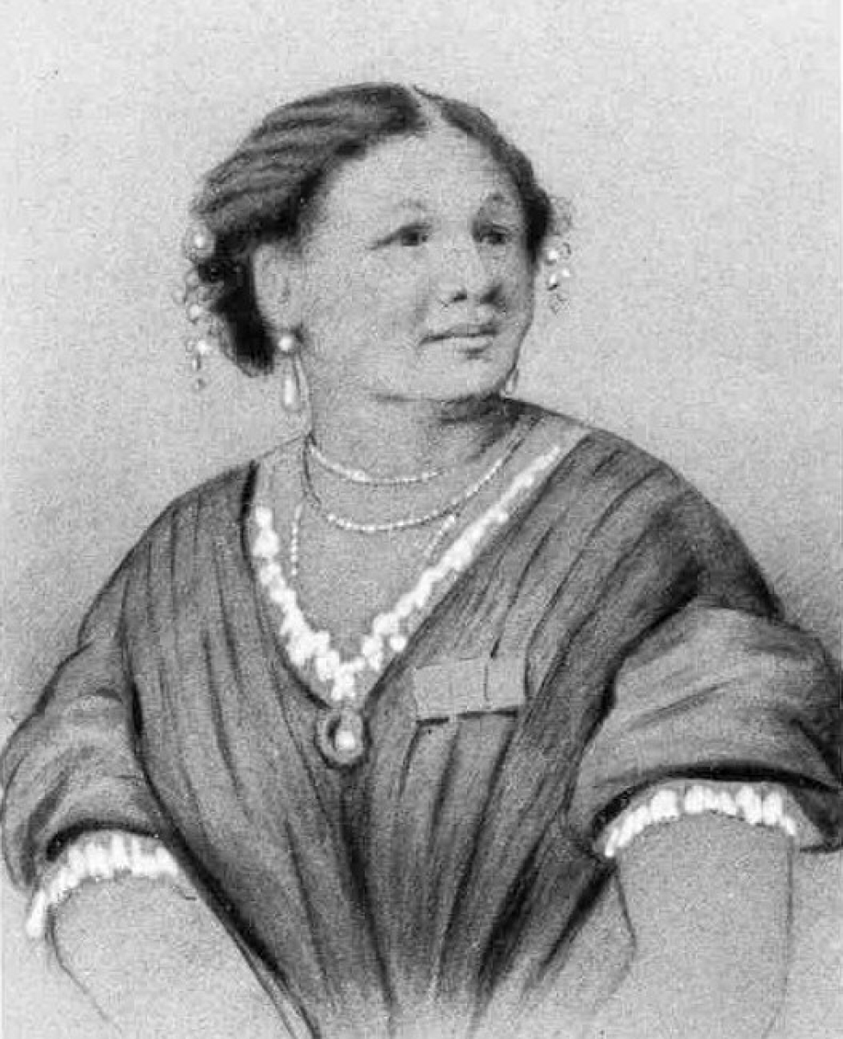
Mary Seacole
1805 – 1881
Mary Seacole lived over 150 years ago. Mary was born in 1805. At this time most black people in Jamaica were slaves. Mary’s mother was a free born black woman and her father was a Scottish soldier. Mary was proud of her skin colour and wanted to be treated equally. Mary’s mother taught her traditional African and Caribbean remedies for illnesses including cholera, diarrhoea and fever. Mary received four medals from a grateful British Government.
In 1857 eighty thousand people turned up to honour Mary in a four-day gala held to raise money for her. Mary’s love for the British army and Britain were inspired by her pride in her Scottish military father. A number of the soldiers fighting in the Crimea had previously been stationed in Jamaica so Mary knew some of them.

Slide 5
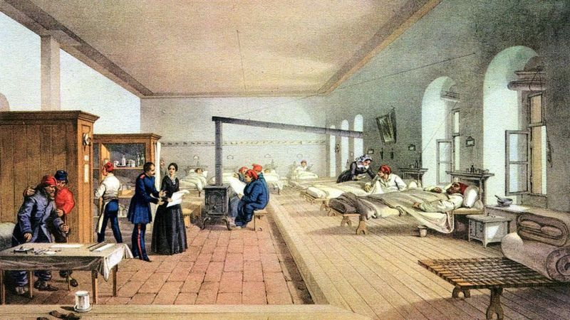
What were hospitals like in the old days?
Back then if you were a soldier your bed sheets would be dirty.
You were very lucky if you got a bed most soldiers lay on the floor of the Hospital.
An old fashioned hospital.. . . Terrible conditions!

Slide 6
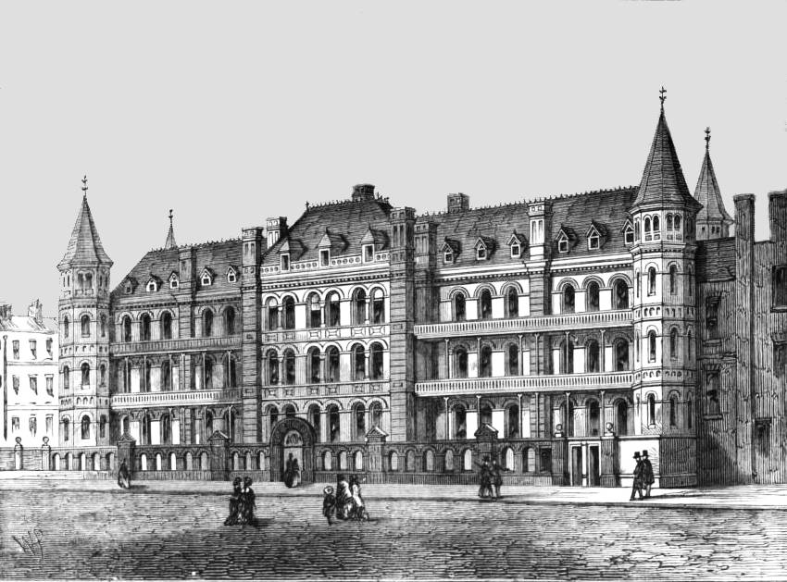
Hygiene!
The Crimean War was the beginning of her hygiene movement. After briefly serving as superintendent of London’s Institution for Sick Gentlewomen in Distressed Circumstances, Nightingale found herself called into action following the outbreak of war in 1853 between Russia and the allied forces of Britain, France and the Ottoman Empire. During the time of the Crimean War hygiene was awful. Most soldiers slept/lay on the floor with the poo, blood, rats and wee.

Slide 7
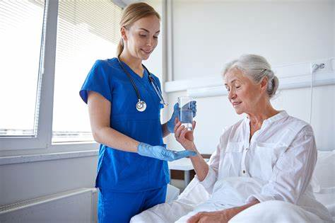
What does a modern nurse do?
Modern nursing care means not only taking care of the patient but administering the care plan, tracking progress, recording vital statistics, administering medication and monitoring diet. Today, there are many elements to modern nursing care that are essential to maintaining good health.
Modern nurses are expected to process complex patient data, carry out research and keep at the cutting-edge of technological advances.
Nurses have many duties, including caring for patients, communicating with doctors, administering medicine and checking vital signs.

Slide 8
What is the difference between a nurse and a doctor?
The main difference lies in the degree. A doctor has MD or undergraduate degree,
A nurse has an undergraduate nursing degree. A nurse could also have degree in another field and later on could take nursing training in a program of master’s degree.
A nurse is an assistant to a doctor, checks on the patient and gatherers information about the patients progress.

