Slide 1
History
Wednesday 13th January 2021

Slide 2
Let’s recap and feedback
Last week, you made a timeline and placed some key legislation on it.
I was SO impressed with your timeline. Those of us in school had to do a bit more on Friday before Golden Time to get it done so wow. Doubly impressive were the people who went onto research some of the laws.
Please make sure you have another look at those laws and where they are on the timeline.
Here’s a few recap slides from the last lesson…

Slide 3
Our topic knowledge organiser
This is what normally gets stuck in your book and shows the sequence of lessons for this term.
RECAP SLIDE FROM LAST WEEK

Slide 4
Wednesday 6th January 2021 WALT: Draw a scaled timeline and revise Victorian legislation
Write this in your book please! Don’t worry about what the title says yet – I’m getting you to do something slightly different to jog your memory as a connect starter!
Do a small spider diagram, noting the things that you remember life was like for children back in the 1800s!
Life for children in the 1800s
RECAP SLIDE FROM LAST WEEK

Slide 5
Now, it’s time for a timeline…
First, we need to be comfortable with how long back we’re going. We’re starting in 1830…
1830 1840 1850 1860 1870 1880 1890 1900 1910 1920 1930 1940 1950
Remember that this is a really, really zoomed in version of the timeline in our class! It’s only 120 years which on our MASSIVE timeline would only be this tiny bit here!
RECAP SLIDE FROM LAST WEEK

Slide 6
Now, it’s time to draw it. You will need a ruler to do it in your book. If you don’t have a ruler, could you make it using a computer?
If you are doing it in your book, you’ll need a double-page spread.
If you make each 10 year span 3cm, you can do it a bit like mine that I’ve just drawn! That means you’ll need 36cm!
RECAP SLIDE FROM LAST WEEK

Slide 7
So, why are we doing this?
It’s so that we can add laws to it as we go!
Now, can you put these on your timeline in the right place?
1831 – No free schools for poor other than Sunday Schools run by churches. In 1831, one in four children went to Sunday school. Some rich children went to schools that cost money.
1837 – Queen Victoria’s coronation. She reigned until 1901.
1842 – Mines Act raised the age of work for miners to 10.
1870 – Just under half of children received an education by this point. Elementary Education Act was passed which meant that all children could receive a primary education. Poor parents would be free and paid for by the government.
1876 – Parents had to send their children to school by law up to age 10.
1891 – Primary education is made free for all.
1902 – Education Act sets up some free high school provision.
RECAP SLIDE FROM LAST WEEK

Slide 8
Task 1
I’m going to give you a task but if you find it far too complicated it really doesn’t matter if you just skip ahead to task 2!

Slide 9
Today’s lesson – first task
Task 1: If you managed the timeline last week, I want you to do one more job.
I want you to, somewhere slightly separate from your dates (e.g. at the bottom of the page, or the very top of the page) draw the length of your life and someone else in your life who matters (e.g. a family member like a mum or granddad).
This is so you can see just how long our lifespans are in comparison to the events on the timeline!
If you followed my instructions last time, that means 3cm = 10 years which means that 3mm = 1 year.
For instance, you could do yourself (if you’re nine, that would mean 2.7cm long, or eight, 2.4cm long) and let’s say you have a dad who is 35, that would mean his line would be 10.5cm long.

Slide 10
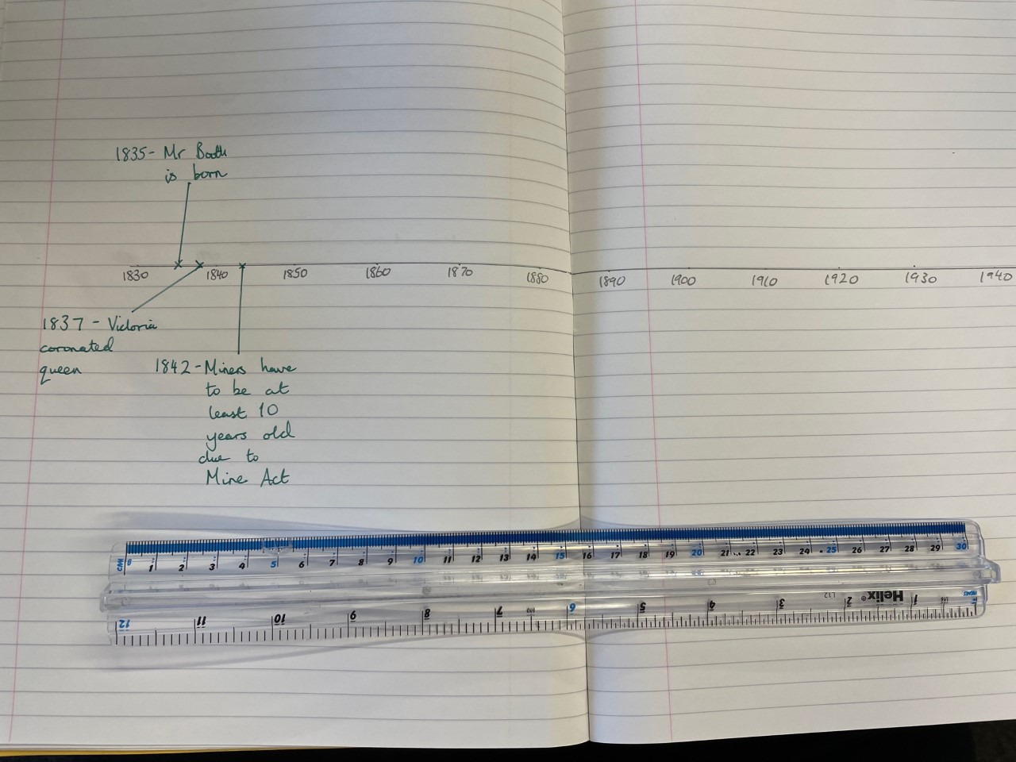
Here’s an example…
Here’s a timeline from last week with some dates added (can you spot my joke additional date?!).
3cm is 10 years remember.

Slide 11
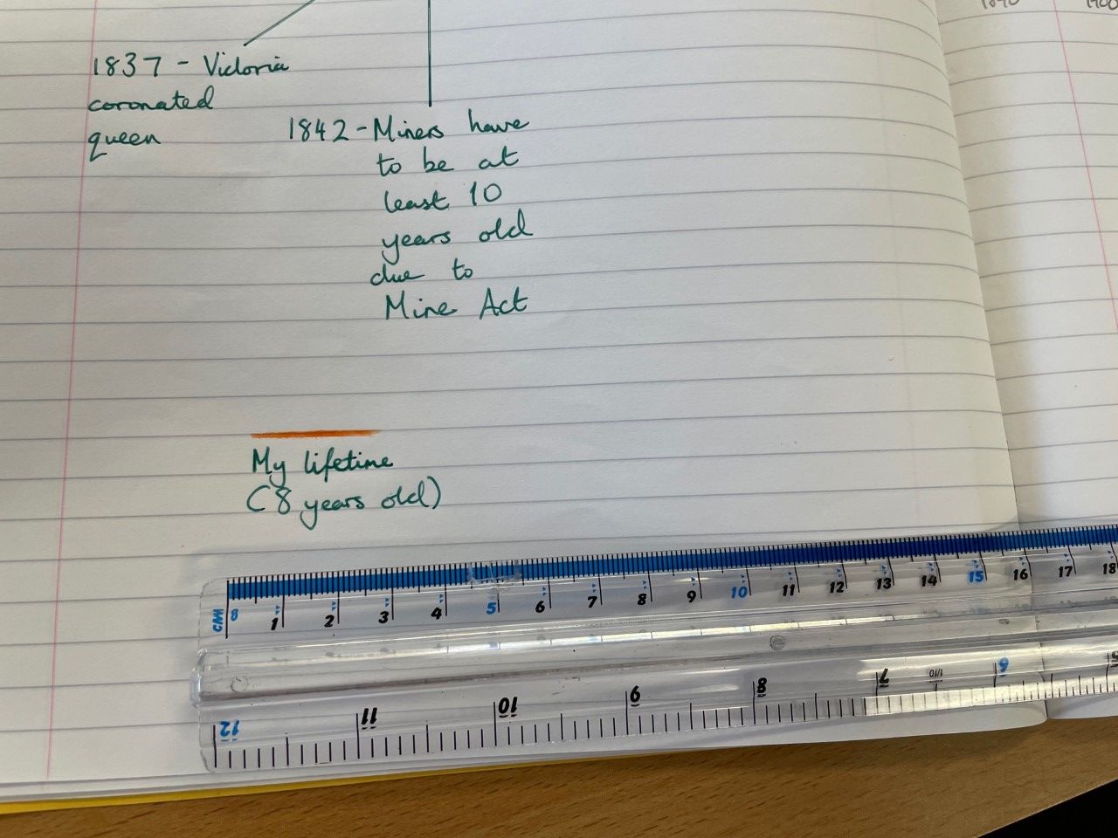
Here’s an example…
Now, let’s see if you’re eight years old… 3mm is 1 year so 8 x 3mm = 24mm or 2.4cm!
9 years old would be 2.7cm!

Slide 12
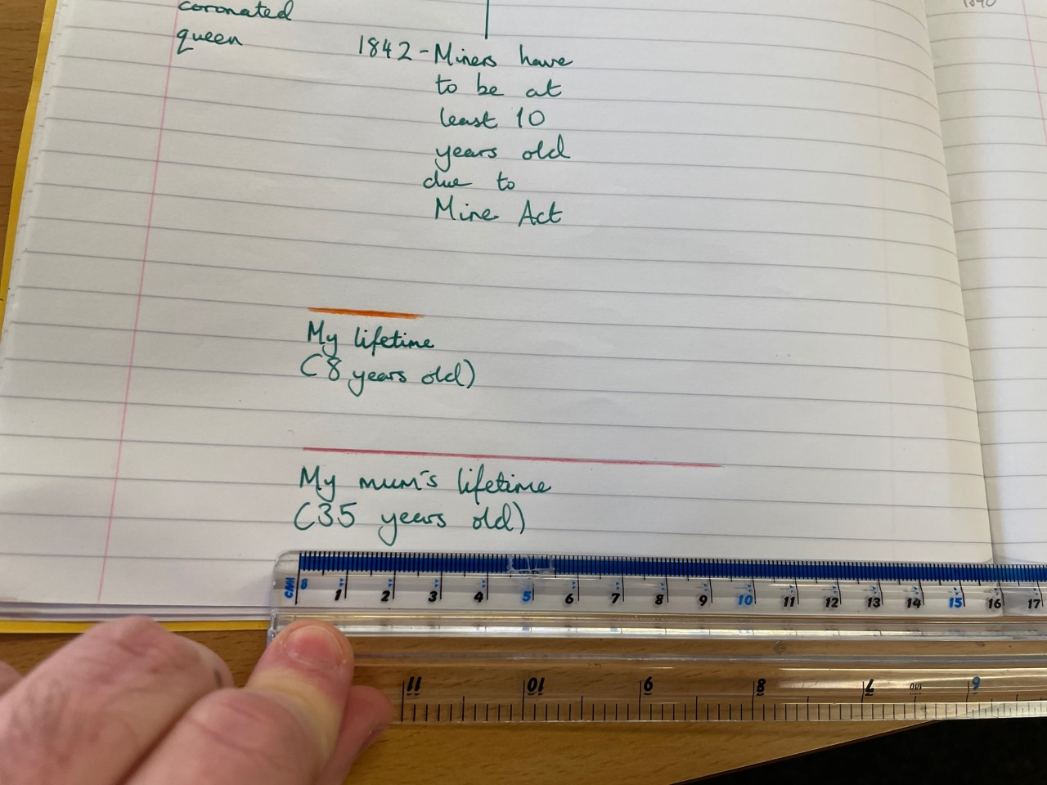
Here’s an example…
Now, I’ve done an imaginary mum who is 35. I made sure it was a different colour and labelled it!
3cm = 10 years 9cm = 30 years
10.5cm = 35 years
If you’re stuck, you can put an age in the yellow box below and it’ll tell you how long to make it!

Slide 13
Please remember that if you can’t manage this (maybe you don’t have a ruler, although if you don’t feel free to pop to school and we’ll give you one!) or maybe you didn’t manage last week’s timeline it’s no big deal!
If you have time, it would be great for you to draw the timeline if you haven’t. Just take a look at the previous slides!

Slide 14
Second task
First, let’s get your date and title in:
Wednesday 13th January 2021 WALT: Analyse sources to examine how things were for children
Now, I want you to take a close look at the following source. This’ll be your Connect Starter!

Slide 15
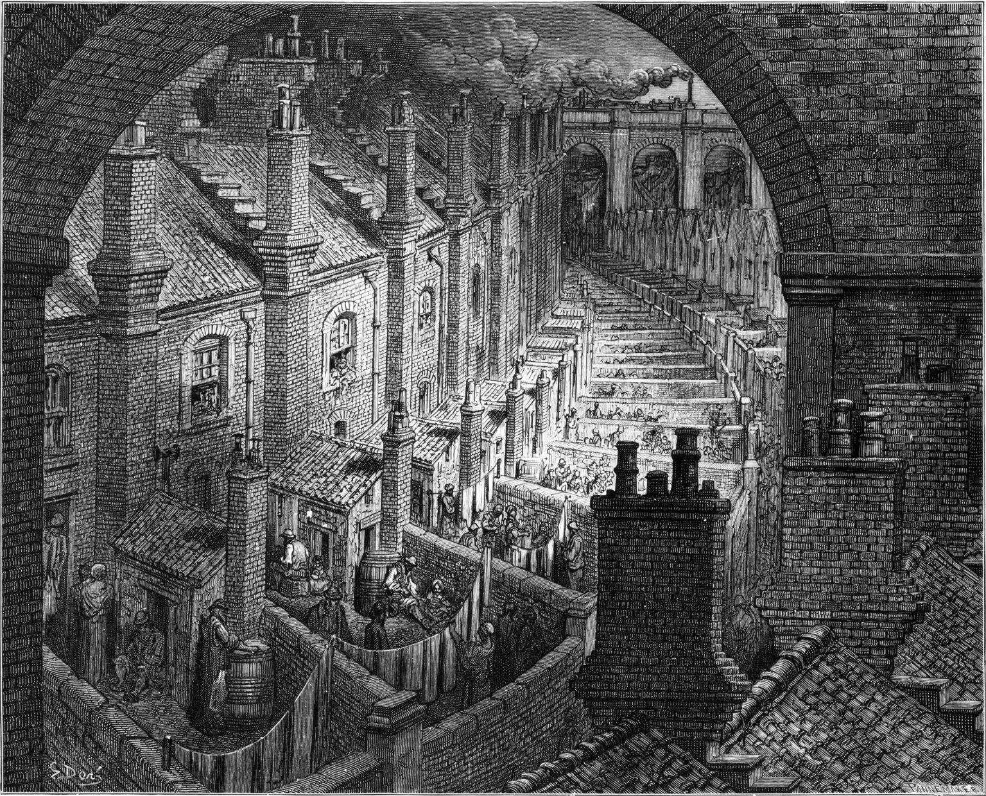
Over London by Rail by Gustave Doré (1872)

Slide 16
Some Context…
Doré was a French artist who did this from memory so it’s not an actual real street of London but is instead his impression.
He spent time amongst the poorest in London.
At the time, many people criticised Doré for only showing the ‘extremes’ of London life. Many felt that these parts of London were improving rapidly and that it wasn’t a fair representation.
You’re going to write about this in your book…

Slide 17
Take some ideas down. Bullet point if you want!
If you’re stuck, look at the next slide which will give you some hints.
If you’re confident, DON’T look at the next slide until you’re done! I’d rather see your ideas than mine!!!

Slide 18
My ideas…
You should definitely notice the dark colour tone, the way houses seem on top of each other. It tells us that living conditions were very poor.
You’re all historians and one of the things about being a historian is, as you know, arguing and also not always trusting sources. The fact it’s from memory means it’s not a real place – has he remembered it accurately?
He’s not from London. He didn’t live there. The fact he chose to live amongst the poorest tells you that he went there because he wanted to find out what it was like for the poor. Why do you think he might do that? How might that make the source a problem?
However, all sources are useful, no matter what! This source tells us that, to outsiders, London was a place of poverty. It tells us that to an outside like Doré it was not a place of beauty!

Slide 19
More sources!
I’m now going to give you some more sources.
What I’d like you to do is write down what you notice about them.
Think about what the source tells you.
Think about why people might have written them at the time. What would the author(s) at the time been trying to say?
Just a few bullet points will do!! You don’t need to write tons and tons!!

Slide 20
In the margin
Please just write Source 1 then bullet point your ideas…

Slide 21
More sources to analyse… Source 1
This is from an 1842 parliament commission (as in the elected people who made the laws) into life for children in the mines. Note how one source is from Percy Main, which is near North Shields!
Use Your Head! Look at the 1842 source. Consider who was collating these quotes from children together. What might their intention have been? What does that tell you about how things were changing?
Bonus for your analysis if you have time!

Slide 22
Source 2
Here’s another piece from Gustave Doré.
It’s called Scripture Reader in a Night Refuge (1872).
Scripture reader means reading the Bible.
A night refuge was a place for homeless people.

Slide 23
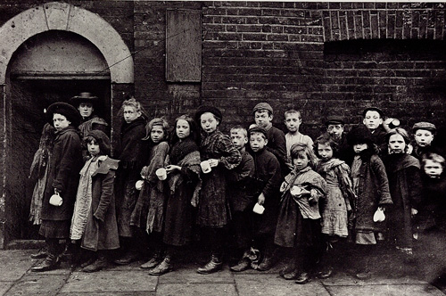
Source 3
Children queuing for breakfast at the Salvation Army, 1900.
Think about why the photographer might have taken the photo.
Look at the timeline and think about how much had already changed by this point!

Slide 24
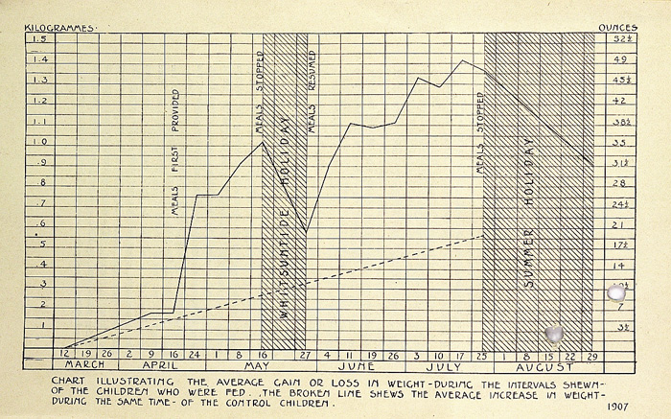
Source 4 (you saw this last year!)
This graph is from a study into the effect of school dinners in 1907.
What does it tell you about the effect of school meals?
Consider what happens over the holiday period. What does that tell you about how much things have changed by 1907 compared to earlier on?

Slide 25
Use your head!
Remember: ragged schools were early schools for poor children before the law introduced free schooling.
I know this was a lot to cover but, if you’d like, I have a special Use Your Head. It’s a few pages from a very interesting source…
Think about how it is written! It is quite judgmental about poorer children.

Slide 26
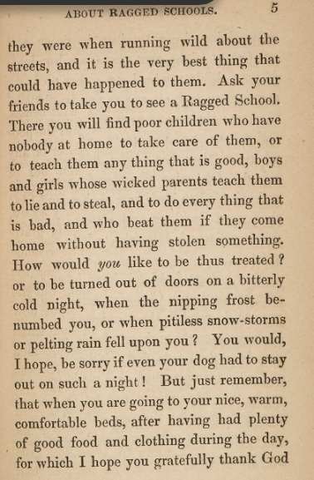
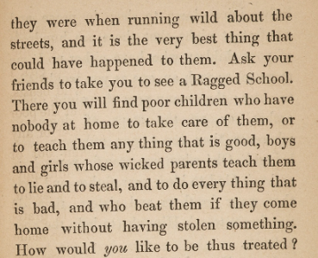
P4

Slide 27
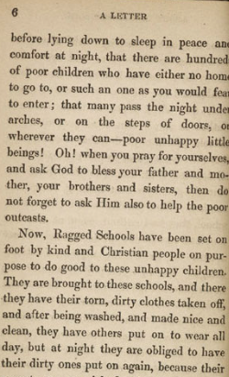
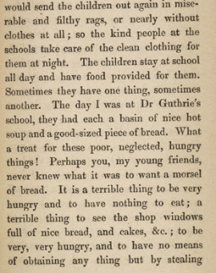
P7

