Slide 1
Friday 15th January
Phonics – Recap and Tricky words

Slide 2



Warm up
Please write your full name in your book.
Today I would also like you to practise writing the ‘g’ sound and the ‘a’ sound
Around the girls face, down her hair and give her a curl.
Around the apple and down the leaf.

Slide 3
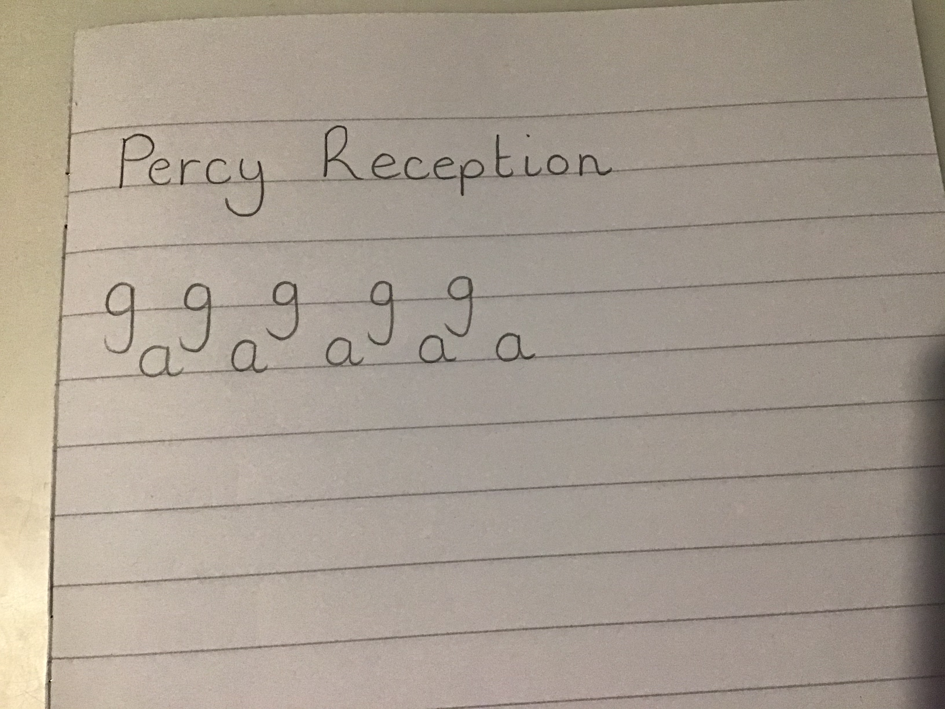

Slide 4
Tricky Words
Tricky words are words which can not be sounded out. We just need to learn them.
On the next page, can you try and read all of the tricky word balloons? I wonder how many you can get right?
This will help children when we are reading as it will make reading more fluent.

Slide 5



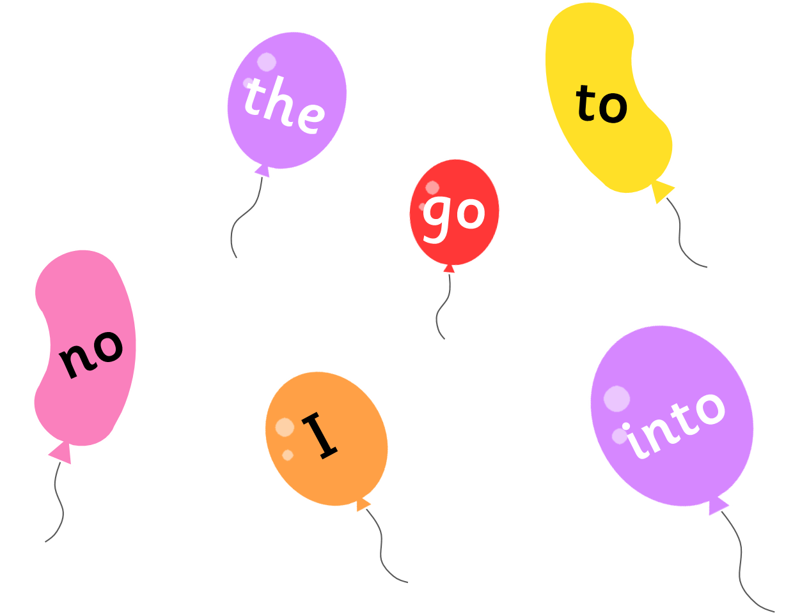


Slide 6

New Tricky Word
Our first new tricky word this week is me.
Can you read the sentence?
Lucas went to the pond with me.

Slide 7

New Tricky Word
Our second tricky word this week is be.
Can you read the sentence?
I will be having fun with Jacob.

Slide 8
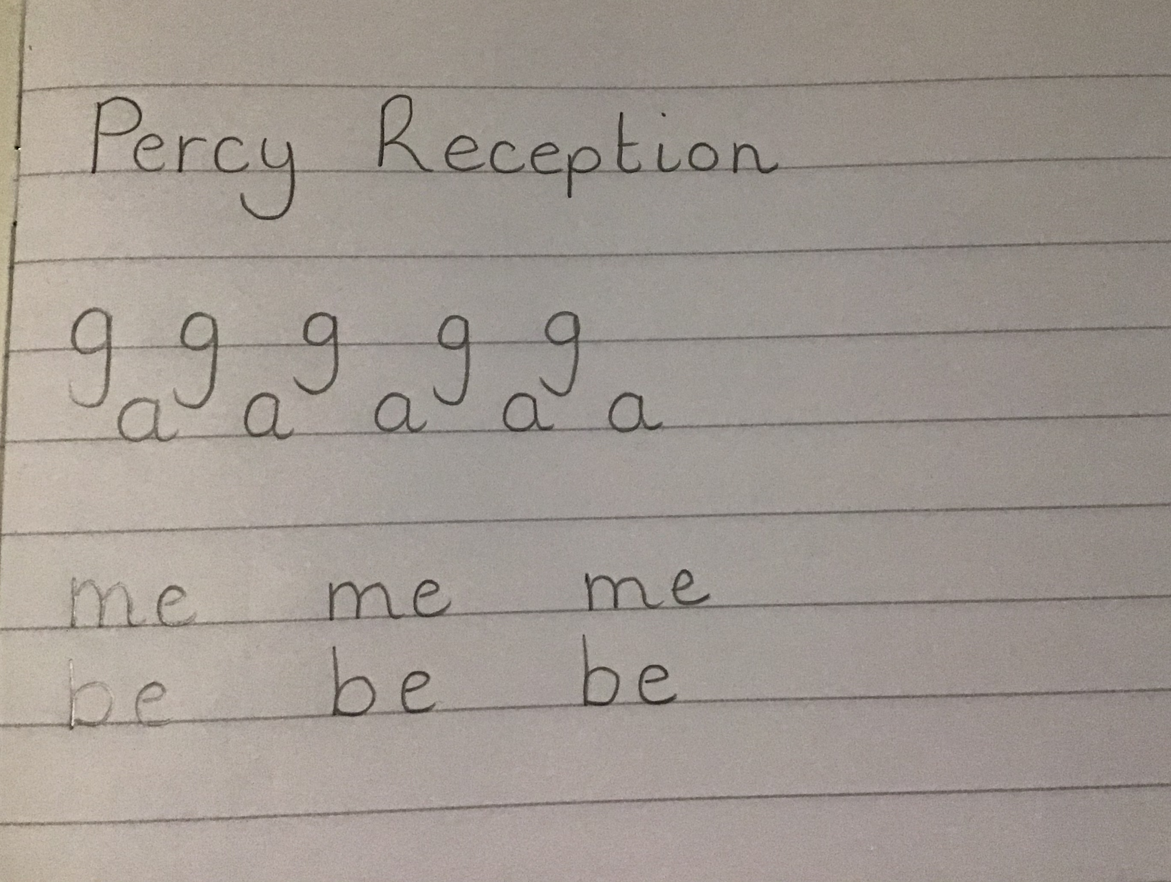
Task
Can you write each tricky word three times in your book. Remember to leave a finger space between each one.
I have added a video on Tapestry to help you with the letter rhymes for these words.

Slide 9
Reading
Next I would like you to have a go at reading two more sentences.
I have put the tricky words in red to help you.
Once you have read the sentence you can click the sound button and I will read it to you to see if you are correct.

Slide 10

The boat went past me.

Slide 11
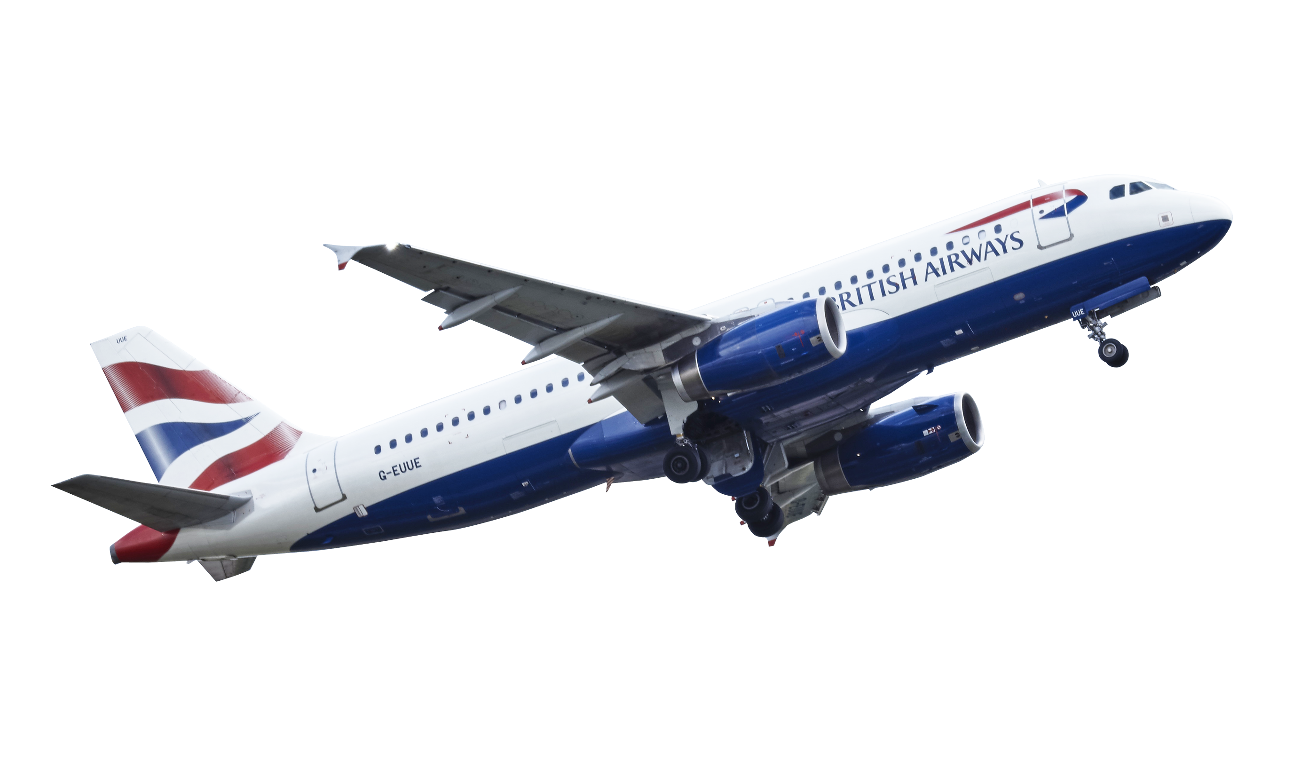
He will be on the flight.

Slide 12
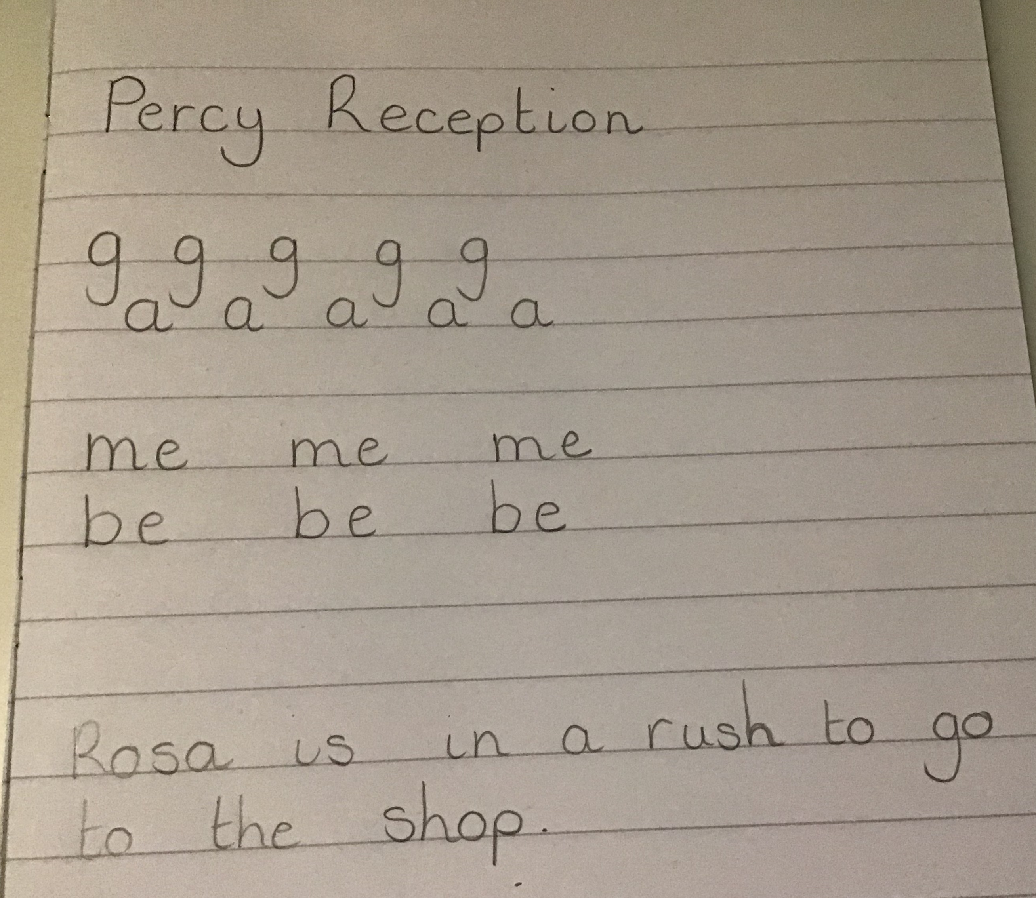
Challenge
If you feel like challenging yourself today I would like you to think of a sentence with a tricky word in.
Can you write it in your book?

