Slide 1
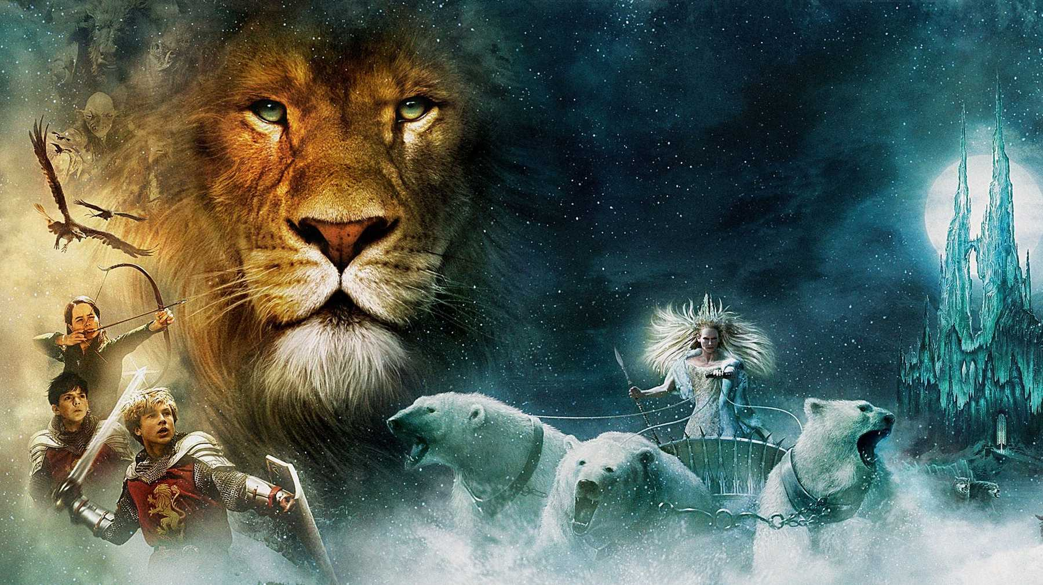
English
Wednesday 13th January 2021

Slide 2
Keeping up to date with the book!
By the end of today, please make sure you’ve read the whole of Chapter 5! (We have to finish up to Chapter 7 by the end of the week!)
https://www.youtube.com/watch?v=d1kXjiqjGs8 Audiobook version
https://www.oasisacademysouthbank.org/uploaded/South_Bank/Curriculum/Student_Learning/Online_Library/KS3/Classics/The_Lion,_the_Witch_and_the_Wardrobe_by_C.S._Lewis.pdf
Here’s a better book version (it has links to each chapter!)

Slide 3
How did we do yesterday?
Yay, Tapestry worked today!!
From what I saw, you’ve really got into the character of Edmund well.
I was pleasantly surprised because I expected tense issues but you seemed to get it right!!
Make sure that your paragraphs are a good length (four or five sentences is fine!)
General spelling was a bit of an issue for those in school so it might be worth a look! I saw some very silly errors here like –t instead of –ed for past tense verbs ‘I turnt around’ and other things similar to that – please check CAREFULLY!

Slide 4
Well done on completing your diary entry yesterday!
Our first task for today’s lesson is to re-read our work and edit! We would normally use our purple polishing pen but you can use your pencil! Here are some suggestions of things to look out for when proofreading your work:

Slide 5
Now, we’re going to start our review
We’re only going to do one or two sentences maximum ok! We’ll do more tomorrow!!
Wednesday 12th January 2021 WALT: Edit and review our work, considering noun phrase usage

Slide 6
Now it is time to review our work.
Review Reminders:
Go through your piece of work.
Pick a sentence that you want to change.
Underline the first word (with a ruler!!).
Write P_S_ for the sentence you're rewriting in the margin.
Rewrite the sentence with your improvements.
Here is an example. Remember you don’t write the original sentence, only the improved sentence. I have just written the original so that you can see the improvements!
The original was… Any way when I entered the wardrobe for one minute I could feel fur on my face and the next minute I was in an arctic sort of place.
P2S1
When I entered the wardrobe, it all started off quite normally. At first, I felt the soft feel of luscious fur on my face as I made my way through the old, dusty clothes. Then, all of a sudden, I felt the freezing cold air on my cheeks. I was in an arctic sort of place.

Slide 7
Review notes
PLEASE ONLY DO ONE OR TWO MAXIMUM!!
I really would love to see your reviewed sentences. You’ll do more tomorrow and do it properly tomorrow!

