Slide 1
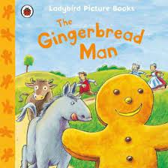
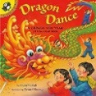
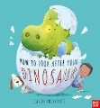
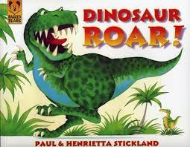
We are reading:
In Personal, Social and Emotional Development we will be:
talking about the special qualities I have
talking about how to stay safe online
talking about the feelings of different characters in The Gingerbread Man
talking about how I would care for a dinosaur egg.
Key vocabulary: feelings, safe, emotions
In Literacy we will be:
reading the texts, The Gingerbread Man, Dinosaur Roar and Am I Yours?
using props and story sack characters to re-tell familiar stories
beginning to hear the initial sounds in words
continuing to copy letters from our name and begin to write it independently
Key vocabulary: ginger, extinct, sly, dinosaur
Nursery
Knowledge Organiser
Spring Term 1 2025
In Communication and Language we will be:
reciting our class poems
learning new words and their meanings such as palaeontologist, excavate, carnivore, herbivore and Jurassic.
talking about my favourite dinosaur and give reasons for my choice
making alliterations for my favourite dinosaur
taking part in a music workshop with Piccolo music
Key vocabulary: palaeontologist, alliteration, communicate
Be courageous; be strong. Do everything in love. 1 Corinthians 16:13-14
Characteristics of Effective Learning
We will be:
Playing and Exploring – investigating and experiencing things, and ‘having a go’
Active Learning – concentrating, keep on trying if we encounter difficulties and enjoying achievements
Creating and Thinking Critically – we will have and develop our own ideas, making links between ideas, and developing strategies for doing things
In Maths we will be:
reciting numbers to 10
reliably counting up to 5 objects
looking at 2d and 3d shapes
introduced to Ten Town characters
subitising to 5 when asked ‘what do you see?’
Key vocabulary: numeral, triangle, square, circle, rectangle
In Physical Development we will be:
developing my fine motor skills with Dough Gym
getting dressed for PE with support
using the climbing apparatus in PE
using scissors to cut along a wavy line
excavating dinosaur bones
moving like a Dinosaur and thinking about how different dinosaurs moved.
Key vocabulary: climb, apparatus, excavate
PE day: Wednesday
In RE we will be:
listening to stories form the bible
listening to the story of Creation
learning about Lunar New Year
talking about Valentine’s Day and the people who love and care for me
Key vocabulary: creation, beginning, love, Lunar New Year
In Understanding the World we will be:
investigating floating and sinking, will the Gingerbread Man sink or float?
building a bridge for the gingerbread man
travelling around the world with the Gingerbread Man
discussing why dinosaurs are no longer here
Key vocabulary: destination, travel, float, sink, extinct, fossil
You can help your child by:
reading their lending library book with them and asking questions about the story
practising getting themselves dressed in the morning
practising putting on their own coat
practising copying their name
Key dates this half term:
Wednesday 15th Jan – Deadline for Rec applications
Thursday 24th Jan – Nur and Rec cake sale
Friday 7th Feb – Family Bingo Night
Thursday 13th Feb – Film Night
Monday 17th Feb - Nursery Forest School
Friday 21st Feb – Staff Training day/ School closes for half term
In Expressive Arts and Design we will be:
using puffy paint to make a gingerbread man
dinosaur sponge printing
using resources to make an excavation picture
making Chinese lanterns and dragons
Key vocabulary: design, create, cut, print

