Slide 2
https://vimeo.com/500381471
Here’s the video link!
As before, remember that the video will ask you to stop at different points to these slides!

Slide 3
Complete the missing numbers to describe the array.
___ + ___ + ___ = ____
3 × ___ = ___
2) 8 + 8 + 8 + 8 = ___ × 8
3) What fraction of the shape is shaded?

Slide 4
Complete the missing numbers to describe the array.
___ + ___ + ___ = ____
3 × ___ = ___
2) 8 + 8 + 8 + 8 = ___ × 8
3) What fraction of the shape is shaded?
5
5
5
15
5
15
4
$$\frac{\text{1}}{\text{2}}$$

Slide 6
Area is the space inside a closed 2-D shape.

Slide 7
Have a think
Which shape would be the best to fill the rectangle?
Why?

Slide 8
Gaps
Which shape would be the best to fill the rectangle?
Why?
The area is 20 circles

Slide 9
Which shape would be the best to fill the rectangle?
Why?

Slide 10
The area of the rectangle is:
20 squares

Slide 11
1
2
3
4
5
6
7
7
The area is ___ squares.

Slide 12
1)
Have a think
9
The area is __ squares.
3)
2)
4
The area is __ squares.
4
The area is __ squares.

Slide 13
Have a think
The green area is __ squares.
2
4
The orange area is __ squares.
The purple area is __ squares.
2
The white area is __ squares.
4
12
The total area is __ squares.

Slide 14
To find the area, I’m going to count the squares.
3
6
9
12
I’m going to use multiples to be more efficient.
4
1
2
3
4
8
5
6
7
8
12
9
10
11
12
4 + 4 + 4 =
12
3 + 3 + 3 + 3 =
12
4 × 3 =
12
3 × 4 =
12
The total area is 12 squares.

Slide 15
Have a think
1)
5 × 2 =
10 squares
2)
1 × 6 =
6 squares
3)
4 × 4 =
16 squares

Slide 16
$$\frac{\text{1}}{\text{2}}$$
1
2
3
$\frac{\text{1}}{\text{2}}$
3
The area is ____ squares.

Slide 17
Have a think
1)
2)
2
$\frac{\text{1}}{\text{2}}$
3
3)
6

Slide 18
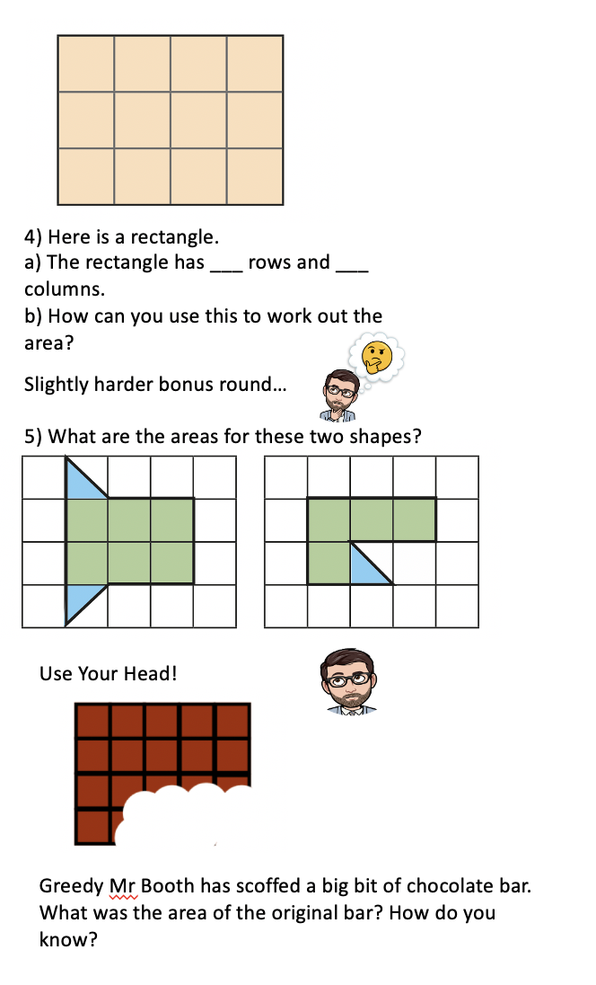
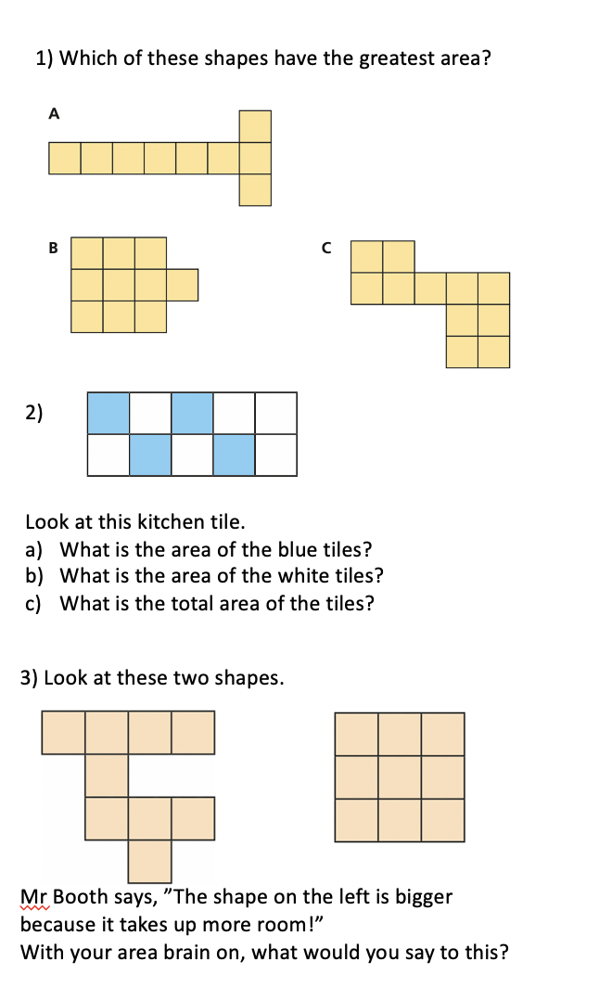
18.1.21 WALT: Count squares to find area

