Slide 1
R.E.
Monday 11th January 2021

Slide 2
Let’s recap…
Remember, most of you were in school last Monday so most of us did last week’s lesson in class!
Sadly, most of us started last week’s lesson but didn’t quite finish it as we had a busy Monday return. That’s ok because, from what I saw in your books, it’s clear you really got it!
The first thing I want you to do is closely re-read some of the slides from last week and remember what you did. It was all about finding the links between Genesis and the Gospel of John.

Slide 3
Firstly…
LAST WEEK’S LESSON – RECAP!
We were going to read Genesis 1 as our class worship today.
What do you think are the important words here? You don’t need to write anything but think about it as it’ll be important later!

Slide 4
John the Baptist
LAST WEEK’S LESSON – RECAP!
For the first few lessons, we are going to be looking at John the Baptist.
Firstly, here’s a good video to remind you a bit about John the Baptist and what he said and did.
https://www.youtube.com/watch?v=7NMHOLPWeTM

Slide 5
The Gospel of John
LAST WEEK’S LESSON – RECAP!
We’re going to be finding out about John the Baptist first through the Gospel of John.
There are four gospels: Matthew, Mark, Luke and John.
It’s really important to note that John the Baptist is not the same person as the person who Christians believe wrote the Gospel of John.
Again, here’s a quick video to recap the Gospels.
https://www.youtube.com/watch?v=SBQiinMzR_0

Slide 6
Now, it’s time to read the beginning of the Gospel of John!
LAST WEEK’S LESSON – RECAP!

Slide 7
LAST WEEK’S LESSON – RECAP! DON’T WRITE ANYTHING IN YOUR BOOK YET!
Monday 4th January 2021 WALT: Understand the beginning of the Gospel of John
Now, answer these questions in your book!

Slide 8
What do I need you to remember from last week?
That our unit is called ‘incarnation’ and is about what Christians believe about the relationship between the Father, the Son and the Holy Spirit.
We’ve begun with the Gospel of John because the start of this Gospel goes through some big ideas to do with Jesus.
Gospel means ‘Good News’ and the New Testament often links back to the Old Testament, like the way John begins talking about ‘the Light’ which harks back to Genesis.
That these are really complicated ideas that many Christians struggle with throughout their life. It’s also something that many Christians disagree about with each other!

Slide 9
Feedback from last week!
So, how did we do last week?
I saw lots about how how ‘the Light’ is Jesus and how the Gospel of John is saying Jesus was there at the beginning. That’s a big idea so well done for getting it!
Some of us got confused about ‘the Word’ – think about what Christians may think about ’the Word of God’ and how this was spread. Who spread it? Who is the Word?
Remember that the most important sentence here is ‘The Word was with God, and the Word was God’. If you can get your head round this, you’ll be well on your way!!
It’s the idea that Jesus is both God and also with God at the same time. It may help Christians understand why Jesus is not mentioned in the Old Testament.

Slide 10
This week…
We’re looking at the similarities and difference between the beginning of different Gospels. Let’s begin by looking at more from John Chapter 1.
In class, we’d do this as our Worship and snack time to give you some time to understand it.
Particularly, read the part about the Baptism closely.

Slide 11
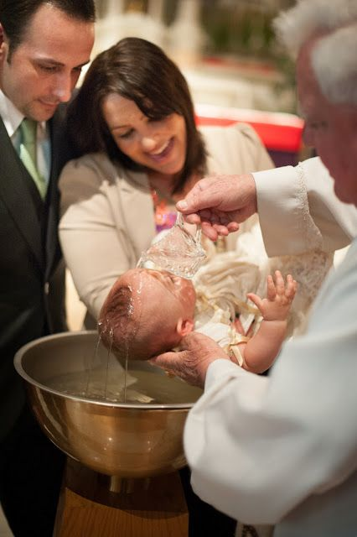
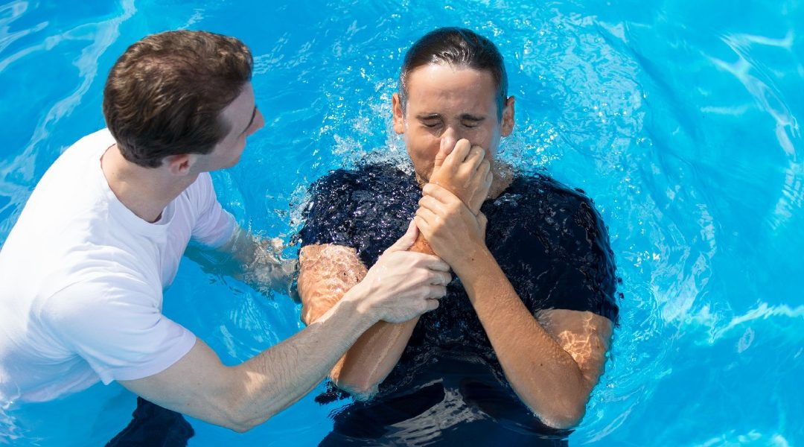
Remind us, what is baptism?
Baptism is something that many Christians do so they can join the church and they are baptised because of what we just read.
They are sometimes baptised as babies and sometimes as adults.
Our next lesson is a lot more about baptism, so all you need to know right now is about the idea that it is about cleansing through water.
Remember that John and Jesus were Jews at the time. There was no Christianity! Christianity came after with people who followed Jesus and the Bible came after Jesus was around.

Slide 12
The other gospels
Quick reminder if you didn’t want it earlier! Do we remember the four Gospels? https://www.youtube.com/watch?v=SBQiinMzR_0
It’s time to read some of the beginning of the other Gospels.
I want you to think: what’s different? Hint: the Gospel of John is quite different!

Slide 13
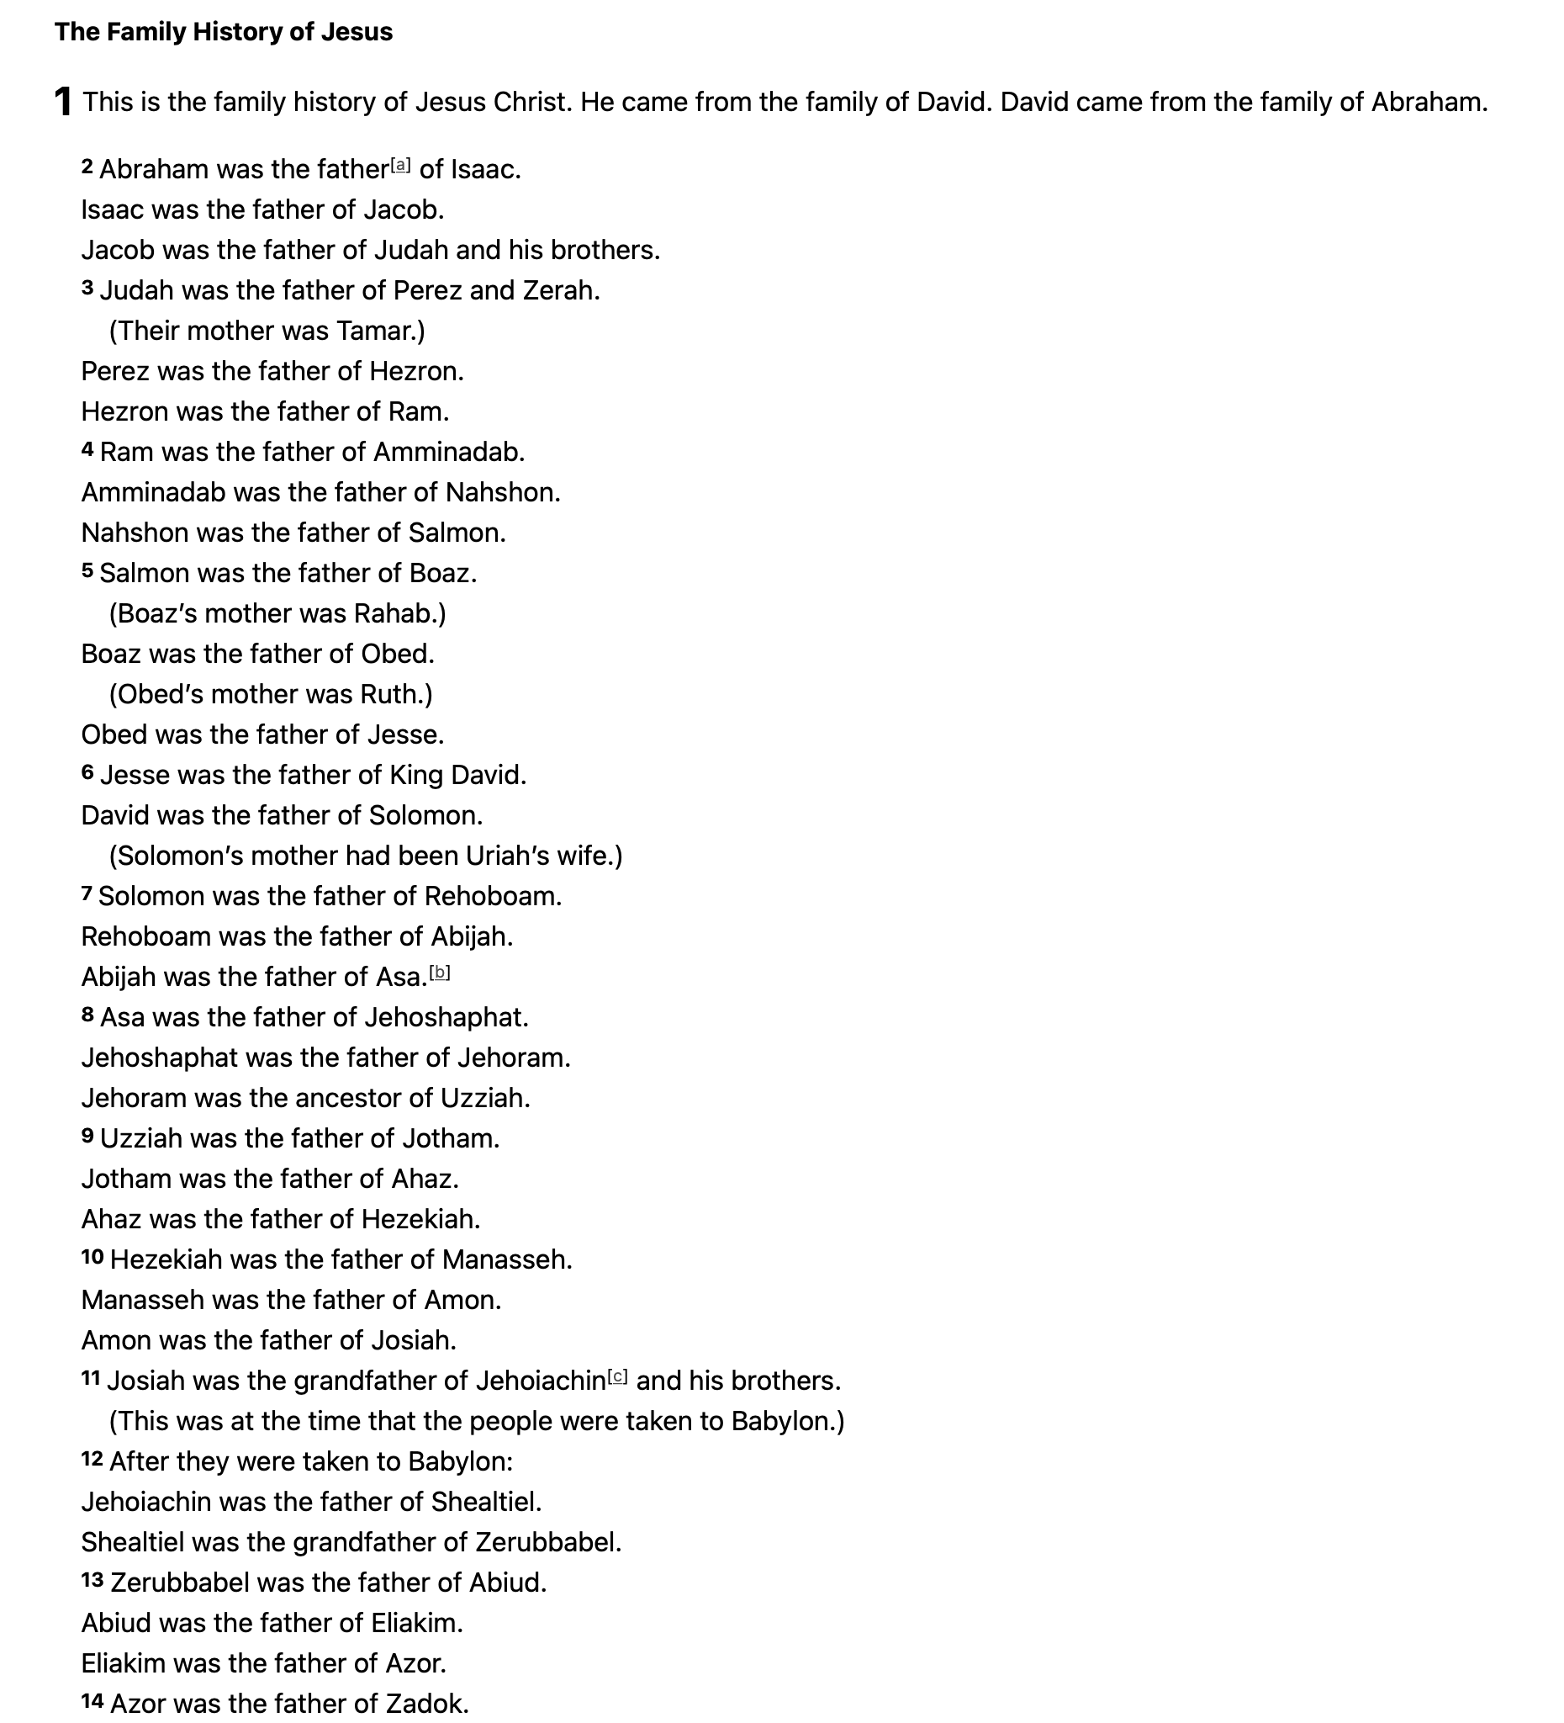
Matthew
Matthew starts first with a family history of Jesus which links Jesus with Abraham (remember from Autumn 1 when we looked at Abraham and Sarah?)
No, you don’t need to remember how they are linked!

Slide 14
Matthew continued
Then, we have a story you’ll all know very well... You saw us teachers act it out!

Slide 15
Stop and think!
Look back at slide 6 and slide 10. How does the Gospel of John start? How is it different and similar?

Slide 16
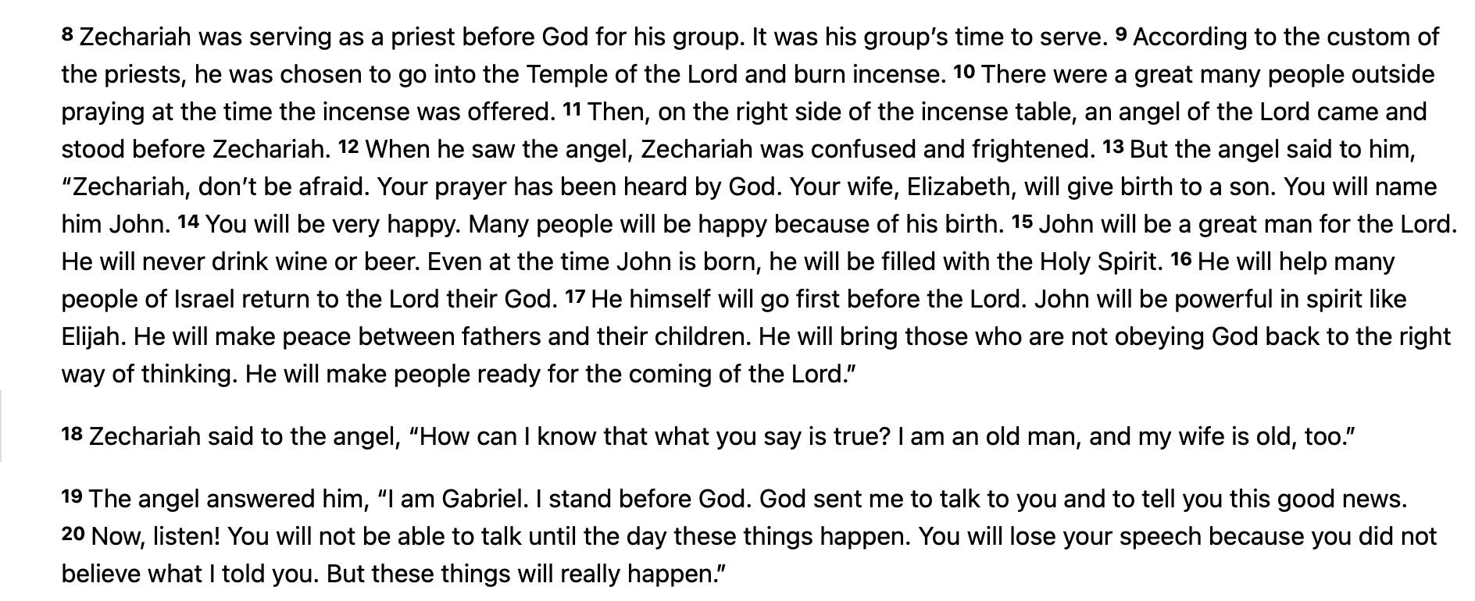
Now, the gospel of luke
Luke starts slightly differently by talking about John’s birth…

Slide 17
Luke continued
But then, Luke tells that story you know very really well!

Slide 18
Stop and think again!
How similar and how different are Matthew and Luke from the start of John?
Think about the way that Matthew and Luke begin before Jesus’s birth, not long before.
Think about how John doesn’t just start with birth… but actually starts at the start of time!! Then, it skips the Nativity to go straight into the baptism!

Slide 19
Date and title in your book now please!
Monday 11th January 2021 WALT: Understand the differences between the start of some of the Gospels
Think of the video!
Reread slides 6 and 10.
Just focus on how the time is different and particularly how different what you looked at last week is to the Nativity story!

Slide 20
Use your head!
Use Your Head!
Look on the next page for Mark!
You may want to research the Old Testament references (that’s the Malachi and Isaiah parts).
Read the beginning of the Gospel of Mark. Where does this fit in compared to the other three Gospels we’ve looked at today?

