Slide 1
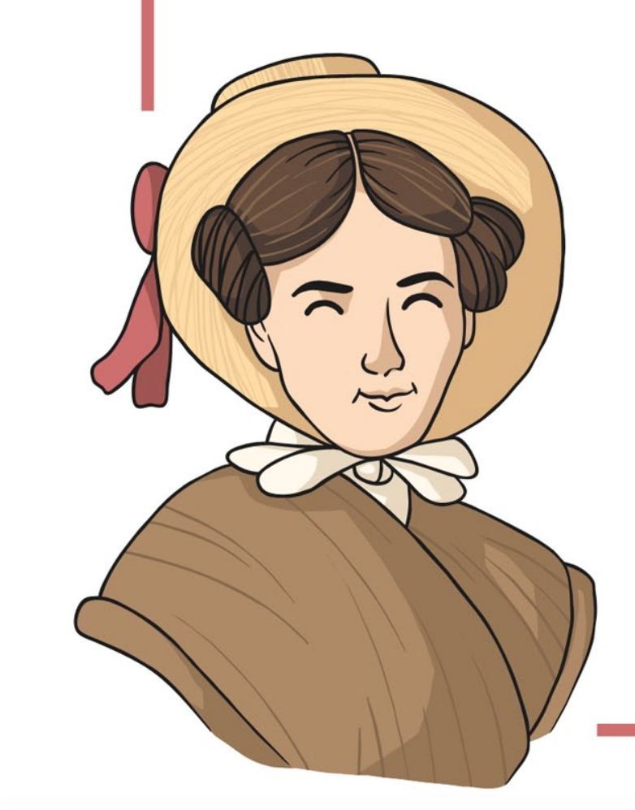
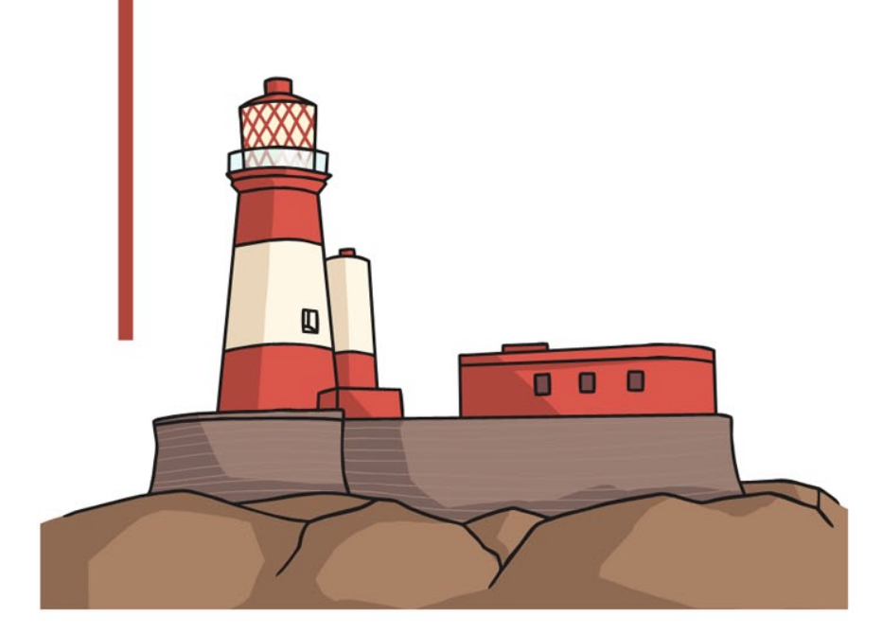
Grace Darling
Lesson 1

Slide 2
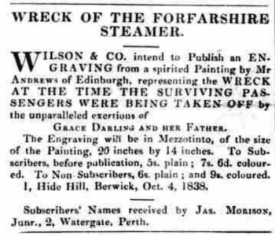
We are looking at newspaper articles, reporting from the day of Grace Darling and her father’s rescue of the survivors from the Forfarshire.

Slide 4
Recap of the story of Grace Darling and her rescue of the Forfarshire.
https://www.youtube.com/watch?v=xCL1x7wHQLY
This week… we are going to plan a newspaper article, reporting from the day of Grace Darling and her father’s rescue of the survivors from the Forfarshire..

Slide 5
Who? Forfarshire Grace Darling | Where? The North Sea The Farne Islands | Key details to include: Spotted from their lighthouse on Longstone. Rescued 9 survivors. | Headline ideas: GRACE DARLING’S RESCUE FORFARSHIRE SURVIVORS
What? Survivors rescued | When? September 1838
Adjectives: Cold, stormy night Brave, amazing young girl Crashing waves

Slide 6
Who? | Where? | Key details to include:
What? | When?
Adjectives:

Slide 7
Grace Darling
Lesson 2

Slide 8
This week… we are going to write a newspaper article, reporting from the day of Grace Darling and her father’s rescue of the survivors from the Forfarshire.
FORFARSHIRE RESCUE
Use your plan to help you with:
Spellings
Writing ideas
Try and remember:
Capital letters
Punctuation
Finger spaces

Slide 9
Grace Darling
Lesson 3

Slide 10
The RNLI Grace Darling Museum at Bamburgh
https://rnli.org/find-my-nearest/museums/grace-darling-in-10-objects

Slide 11
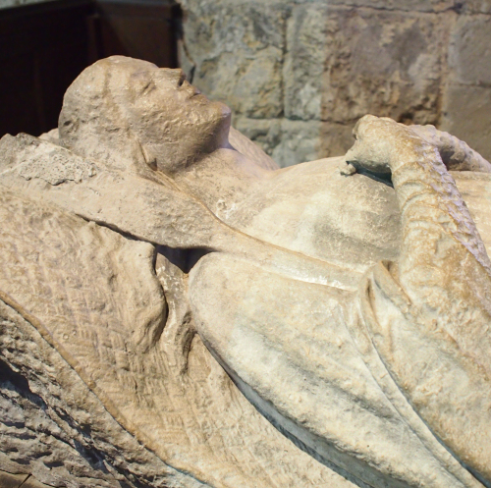
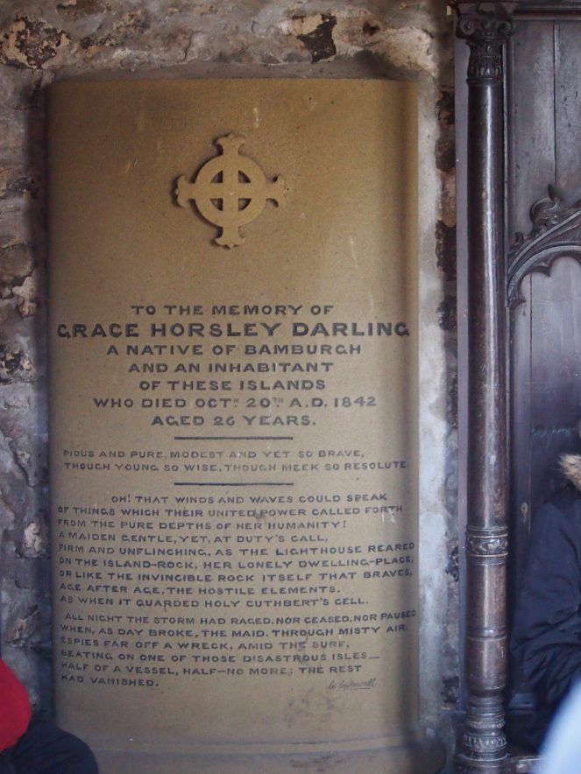
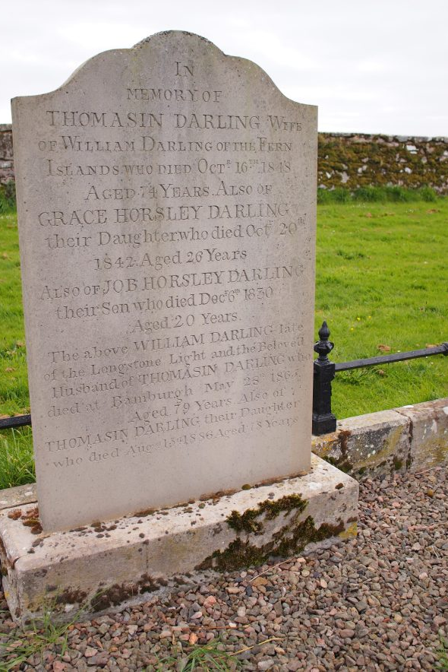
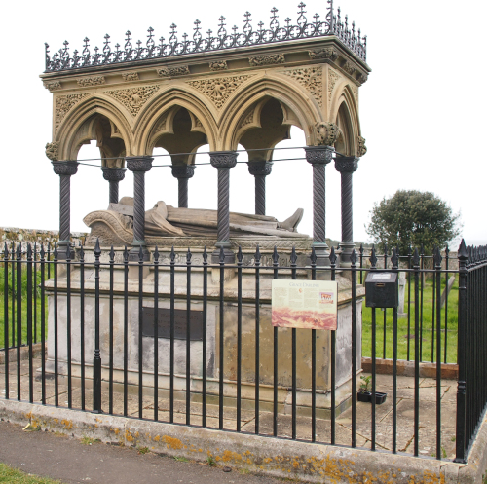
https://flickeringlamps.com/2017/07/30/remembering-grace-darling-heroine-and-victorian-media-sensation/

Slide 12
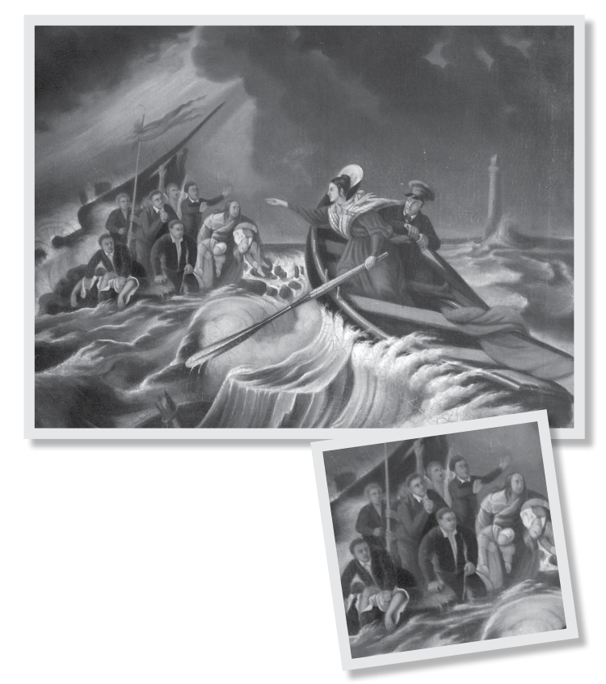
This picture was painted to remember when Grace Darling and her father William rescued the survivors from the Forfarshire.
Look at the picture and think about:
How would you describe the people in the painting?
What is happening in the picture? – What part of the rescue was this?
Do you think the painting tells the story well?
What could be a title for the painting?

Slide 13
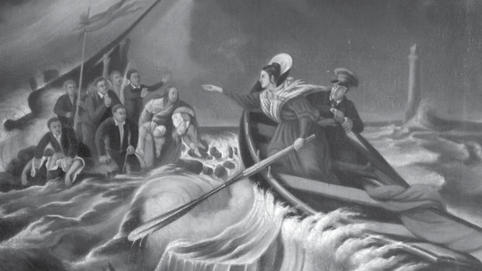

Slide 14
Grace Darling
Lesson 4

Slide 15
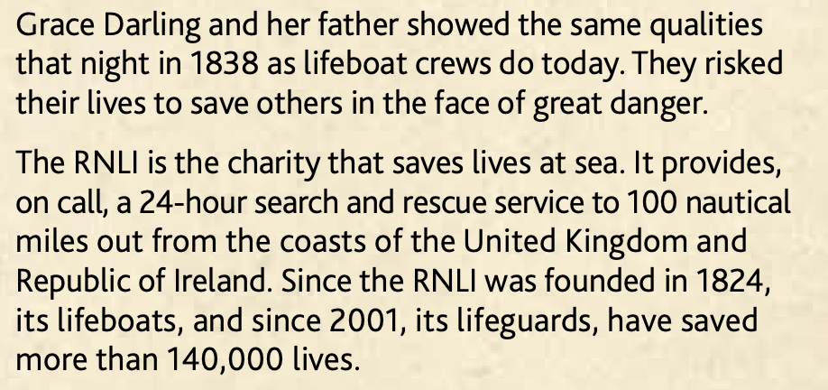
RNLI and Grace Darling
What did the RNLI award Grace and her father with?
How and why do the actions of Grace and her father inspire people to be brave and continue to save people at sea?

Slide 16
What is the RNLI?
What does ‘RNLI’ stand for?
How can they keep us safe?
Where are the RNLI near us?
How do we get in touch with the RNLI?

Slide 17
What is the RNLI? What does ‘RNLI’ stand for?
A charity that helps save lives at sea through lifeboats and lifeguards. It stands for ‘Royal National Lifeboat Institution’.
How can they keep us safe?
If we get in trouble in the sea, the lifeboats and lifeguards can rescue us using their specialist training and equipment.
Where are the RNLI near us?
https://rnli.org/find-my-nearest/lifeguarded-beaches?display=Grid&resultsPerPage=12&lat=54.986639223471734&lon=-1.4475737209156625&radius=31
How do we get in touch with the RNLI?
If you or somebody you can see is in trouble in the water, you should call 999 and ask for the coastguard.

Slide 18
Staying safe in the sea!
You can use this template or design your own.
Remember to include:
What number to call in an emergency and who to ask for
Where some of our nearest lifeguarded beaches are

