Slide 1
11.1.21
WALT: Divide 2 digits by 1 with remainders.
Please watch the video link to help your understanding of today’s lesson!
https://vimeo.com/497936690

Slide 3
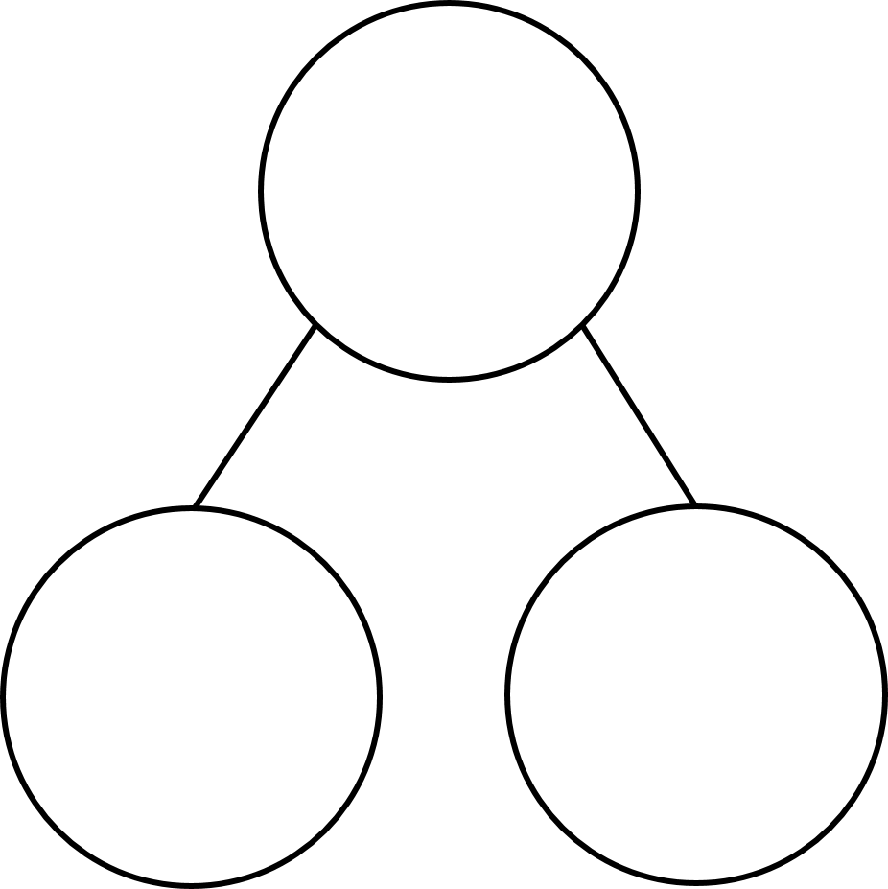

13 $÷$ 3 $=$
Complete the part whole models
5 $+$ 4 $=$ 10 $+$ 4 $=$
15 $+$ 4 $=$ 20 $+$ 4 $=$
25 $+$ 4 $=$ 30 $+$ 4 $=$
35 $+$ 4 $=$
73
73
3
60

Slide 4
13 $÷$ 3 $=$
Complete the part whole models
5 $+$ 4 $=$ 10 $+$ 4 $=$
15 $+$ 4 $=$ 20 $+$ 4 $=$
25 $+$ 4 $=$ 30 $+$ 4 $=$
35 $+$ 4 $=$
4 remainder 1
73
13
73
70
3
60
9
14
19
24
29
34
39

Slide 6


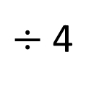
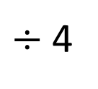
87 ÷ 4 =
21
remainder 3
87
Tens | Ones
80
7
$÷$ 4
$÷$ 4
20
1 r 3

Slide 7

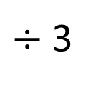
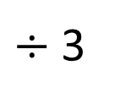
73 ÷ 3 =
24
remainder 1
Have a think
73
Tens | Ones
60
13
$÷$ 3
$÷$ 3
20
4 r 1

Slide 8
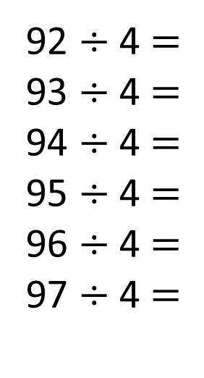

Have a think
72 ÷ 3 $=$
73 ÷ 3 $=$ 24 r 1
74 ÷ 3 $=$
75 ÷ 3 $=$
76 ÷ 3 $=$
92 ÷ 4 $=$
93 ÷ 4 $=$
94 ÷ 4 $=$
95 ÷ 4 $=$
96 ÷ 4 $=$
97 ÷ 4 $=$
23
23 r 1
23 r 2
23 r 3
24
24 r 1
24
24 r 2
25
24 r 3
25 r 1
The remainder must be less than the divisor.

Slide 9
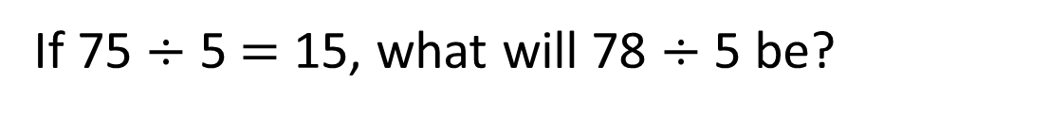
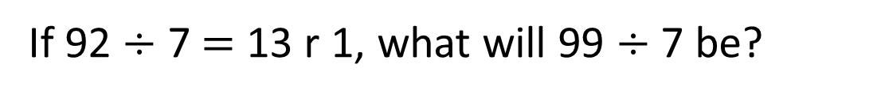
72 ÷ 3 $=$
73 ÷ 3 $=$ 24 r 1
74 ÷ 3 $=$
75 ÷ 3 $=$
76 ÷ 3 $=$
92 ÷ 4 $=$
93 ÷ 4 $=$
94 ÷ 4 $=$
95 ÷ 4 $=$
96 ÷ 4 $=$
97 ÷ 4 $=$
23
23 r 1
23 r 2
23 r 3
24
24 r 1
24
24 r 2
25
25 r 1
Have a think
The remainder must be less than the divisor.
If 75 $÷$ 5 $=$ 15, what will 78 $÷$ 5 be?
15 r 3
If 92 $÷$ 7 $=$ 13 r 1, what will 99 $÷$ 7 be?
14 r 1

Slide 10
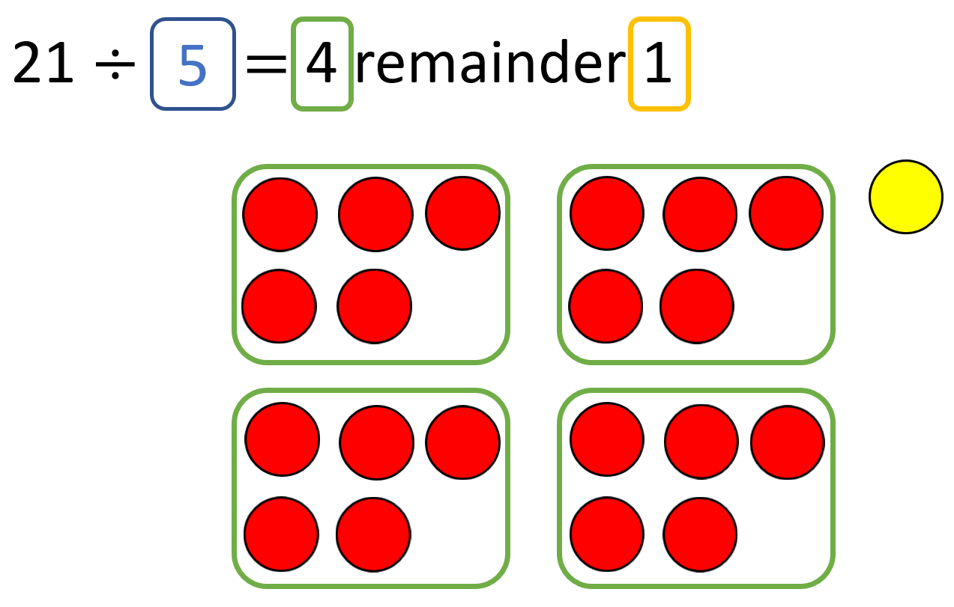
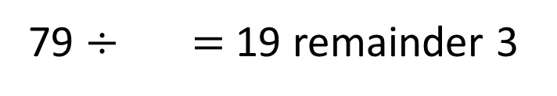
79 $÷$ $=$ 19 remainder 3
4
Have a think

Slide 11
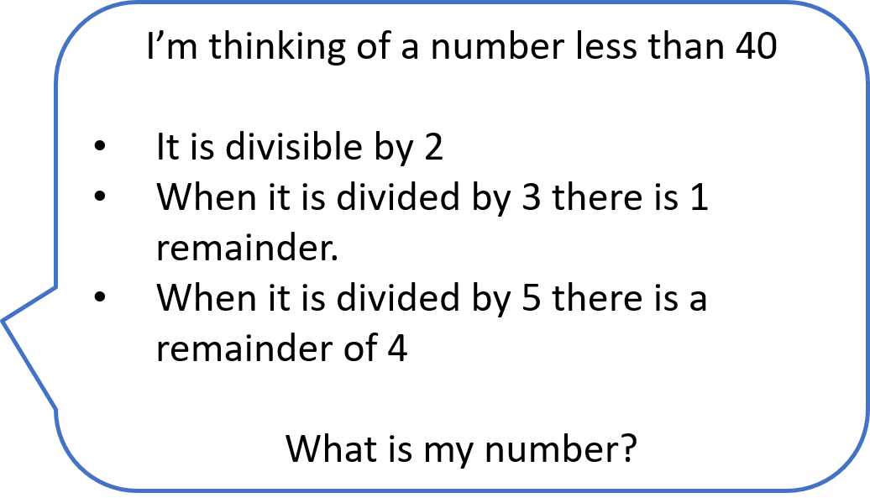

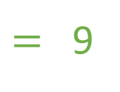
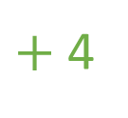

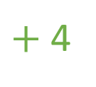
I’m thinking of a number less than 40
It is divisible by 2
When it is divided by 3 there is 1 remainder.
When it is divided by 5 there is a remainder of 4
What is my number?
5
$+$ 4
$=$ 9
10
$+$ 4
$=$ 14
r 2
34
19
24
r 0
29
34
r 1
39

Slide 12
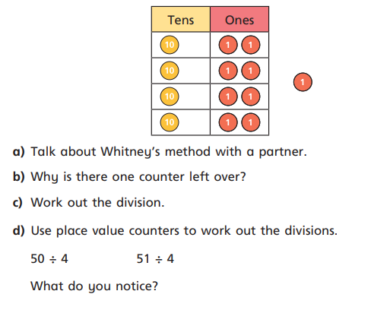
Task One:
1. Miss Fitzgerald is working out 49 ÷ 4 using a place value chart.
Why is there one counter left over?
Work out the division.
c) Use place value counters to work out the divisions.
50 ÷ 4 = 51 ÷ 4 =
What do you notice?
2. Work out the divisions:
32 ÷ 5 = b) 47 ÷ 3 =
c) 49 ÷ 6 = d) 89 ÷ 4 =

Slide 13
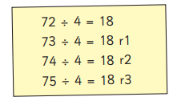


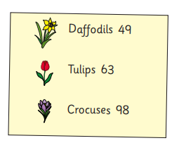
Miss Burns is working out some divisions.
Why does Miss burns think this?
Explain why she is wrong.
2. Miss Nattress has these bulbs:
Equal numbers of each bulb are put into 4 tubs.
a) How many of each bulb will be put in each tub?
b) How many of each bulb will be left over?

Slide 14
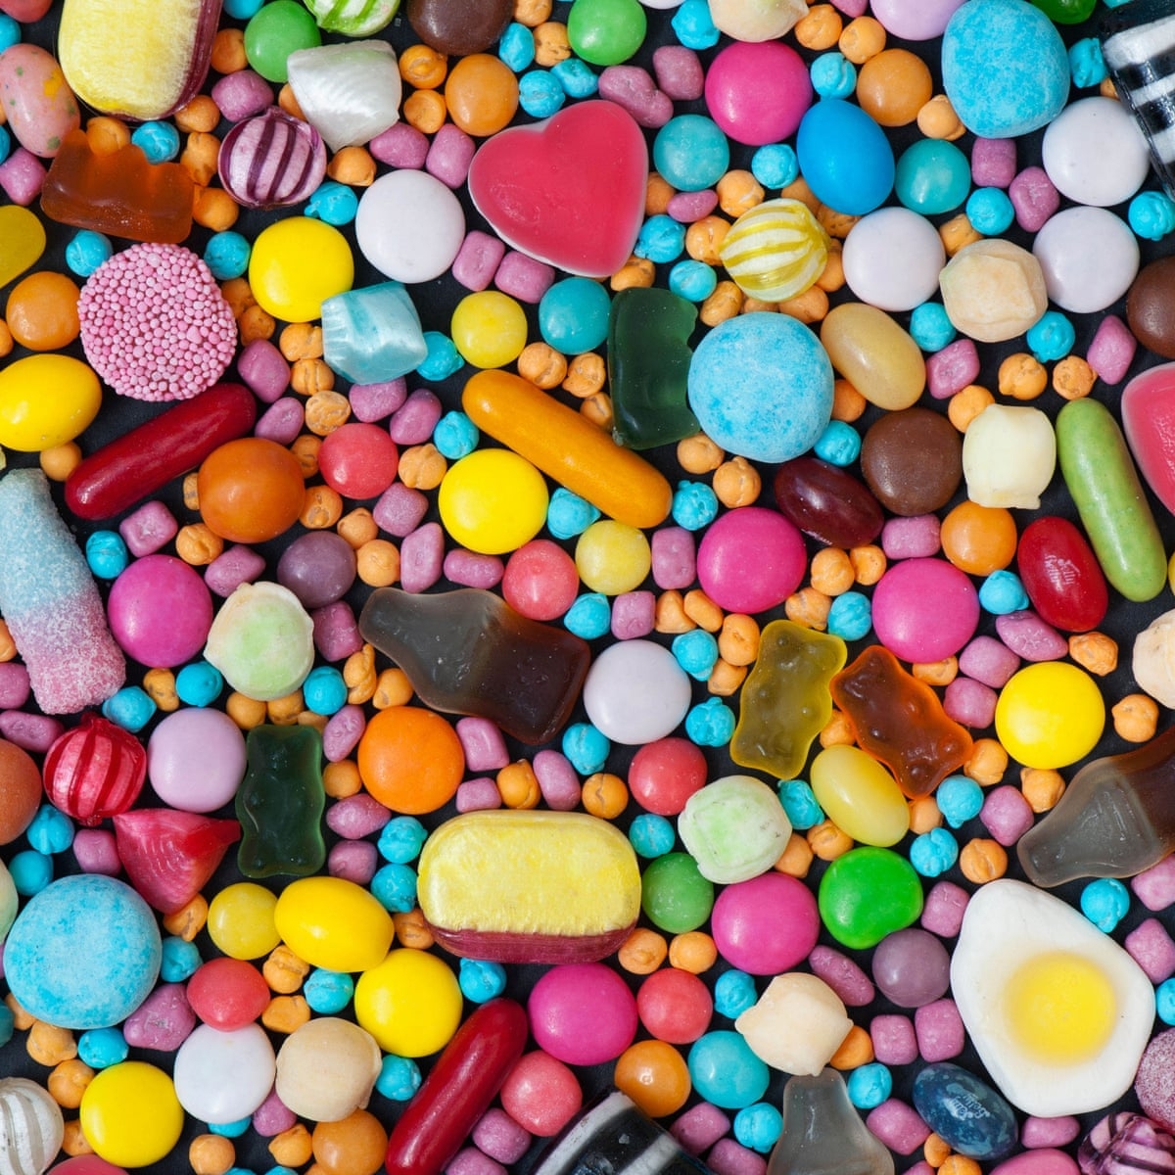
Use Your Head:
37 sweets are shared between 4 friends. How many sweets are left over?
Four children attempt to solve this problem.
Umaiza says it’s 1
Jacob says it’s 9
Oscar says it’s 9 r 1
Emilia says its 8 r 5
Can you explain who is correct and the mistakes others have made?
Use Your Head (part 2):
Miss Burns is thinking of a 2-digit number that is less than 50.
When it is divided by 2, there is no remainder.
When it is divided by 3, there is a remainder of 1.
When it is divided by 5, there is a remainder of 3.
What number is Miss Burns thinking of?

