Slide 1
Thursday 14th January
Phonics – oa sound

Slide 2
Warm up
Write your full name
Practise writing the oa sound 3 times in your book, leaving a finger space between each one. There is a video on the next slide to help you form your letters correctly.

Slide 3
oa Video
Please watch the phonics video on Tapestry. This will help you with the letter rhymes to form the oa sound correctly.

Slide 4
Reading the oa sound
Read the oa story with your grown up
Purple words – are decodable or common words which children can begin to read
Red words – new tricky words which can not be decoded.

Slide 6
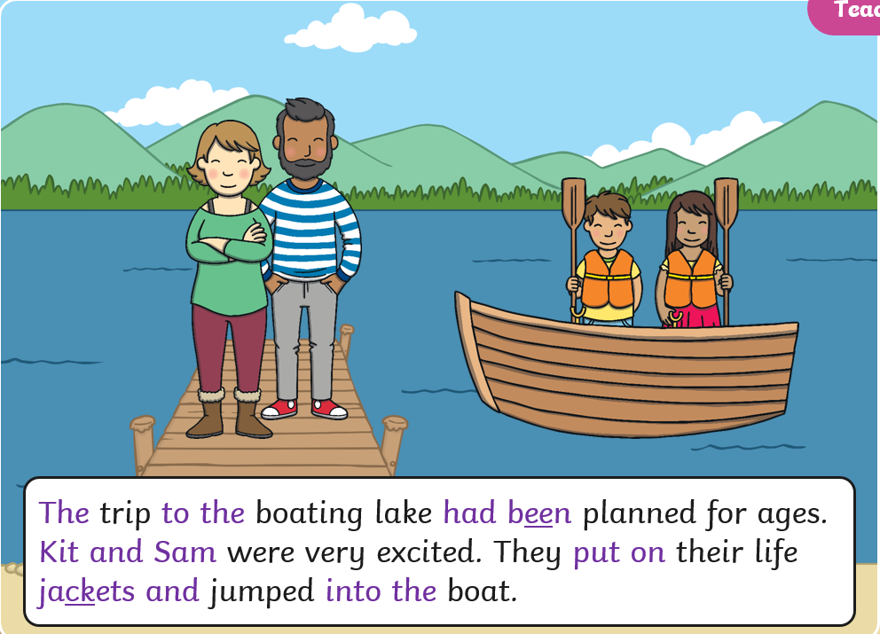

Slide 7
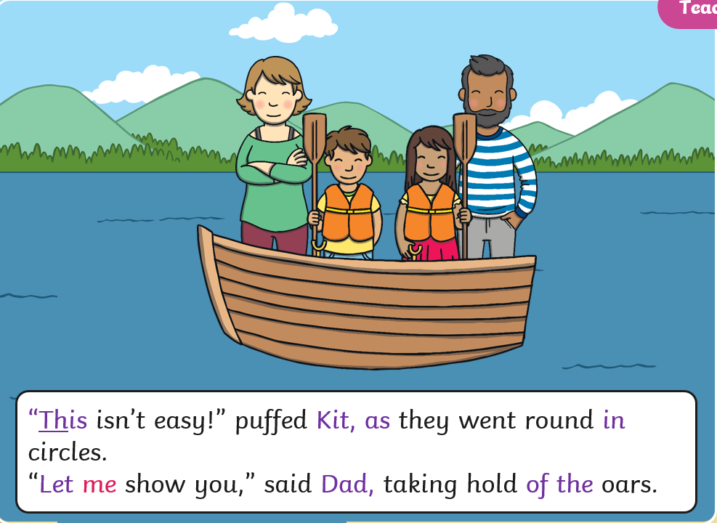

Slide 8
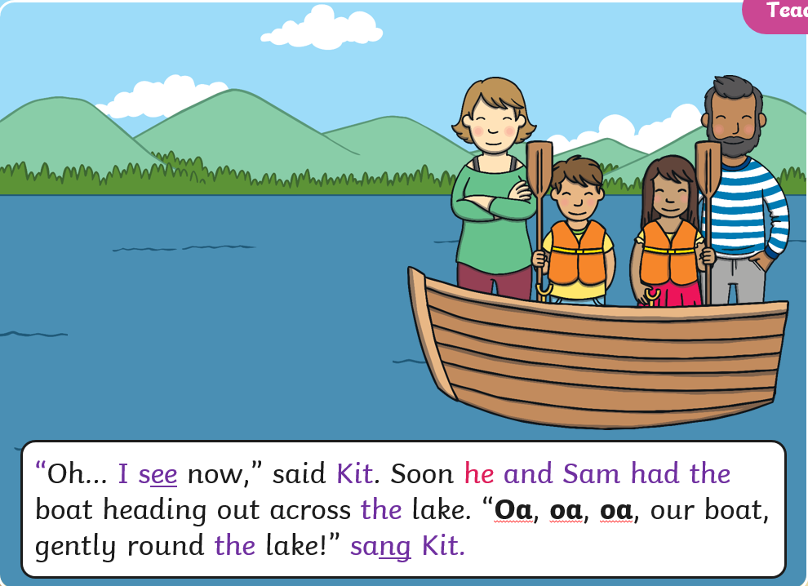

Slide 9
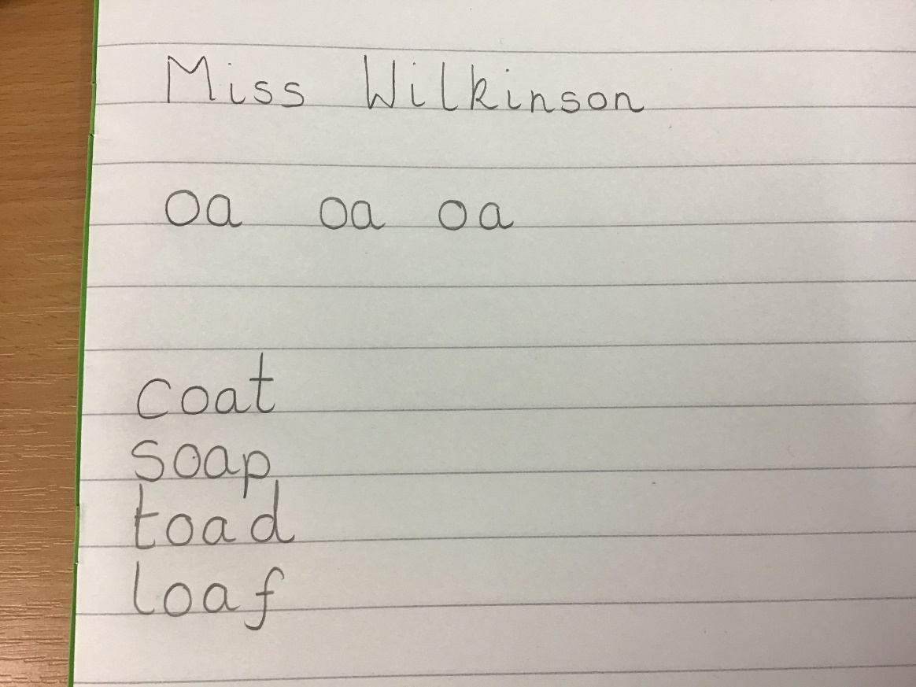
Please set your work out like this.

Slide 10
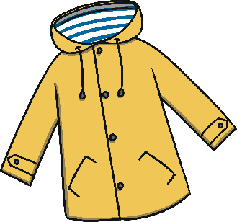

Slide 11
c
oa
t

Slide 13
s
oa
p

Slide 14
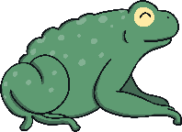

Slide 15
t
oa
d

Slide 17
l
oa
f

Slide 18
Sentence Time
When writing a sentence say the sentence lots of times so you can remember it.
Count how many words are in the sentence so you can check you are writing all of the words.
Make sure you sound out each word carefully and leave finger spaces between each word.
Listen to the sentence I would like you to write in your books.

Slide 19
The goat is on a boat.

