Slide 1


Geography
Beside the Seaside
Year One
Geography | KS1 | Beside the Seaside | Where are Our Seasides? | Lesson 1

Slide 2
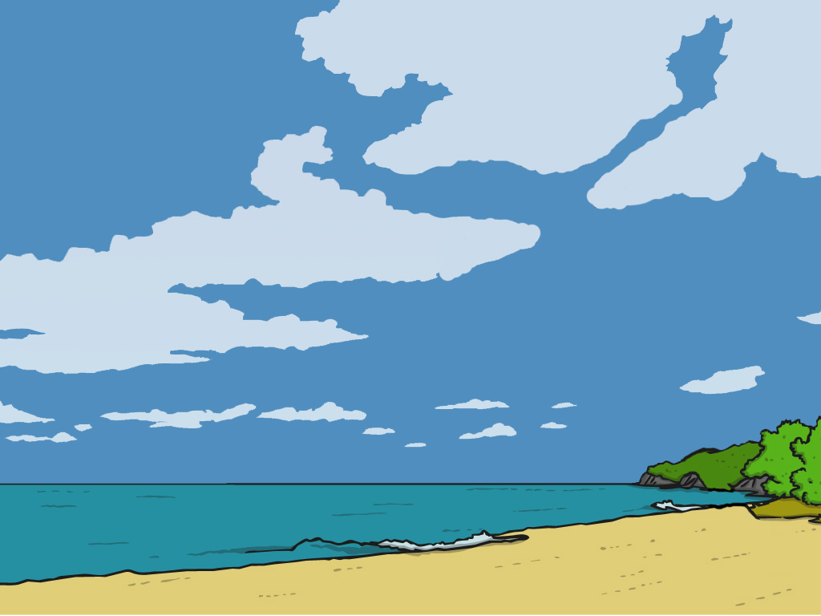

Where are
Our Seasides?

Slide 3
Aim
I can use key words to describe different places and environments.
I can use a map to find seaside locations.
Success Criteria
I can use key words to describe different places I have visited.
I can talk about the different types of environments that people can visit and describe what they are like (town, village, city, countryside, seaside).
I can use key words to describe what seaside locations are like.
I can locate (find) our nearest seaside resort on a map.
I can find out three facts about our nearest seaside resort.

Slide 4


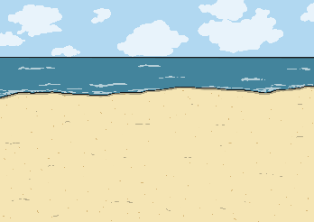
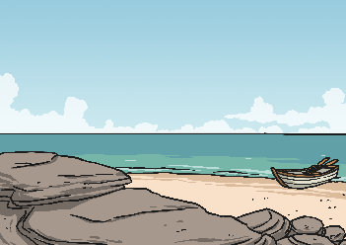
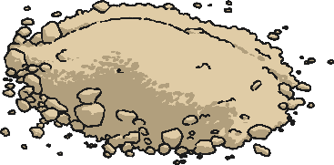
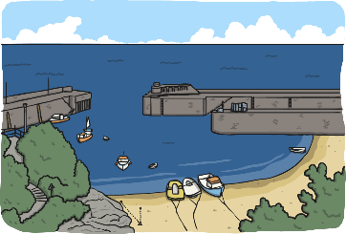
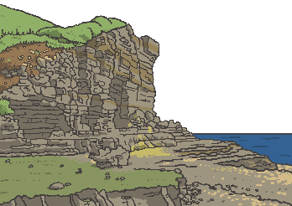
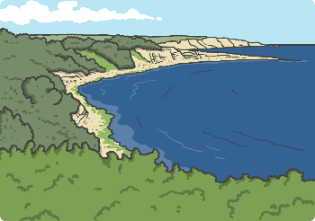
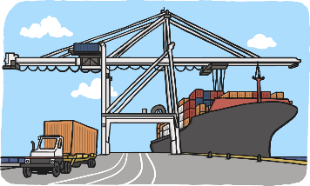
Key Words
weather
beach
sand
shore
harbour
cliff
coast
port

Slide 5
What do I Know Already?
Quick Quiz
1. Write 5 words that describe the seaside.
2. Why do people visit the seaside?
3. Can you name any seaside places in the __UK (resorts)?
4 What is an Island?
5. How might the seaside be different from __where we live? Can you write / say
__2 differences?

Slide 6

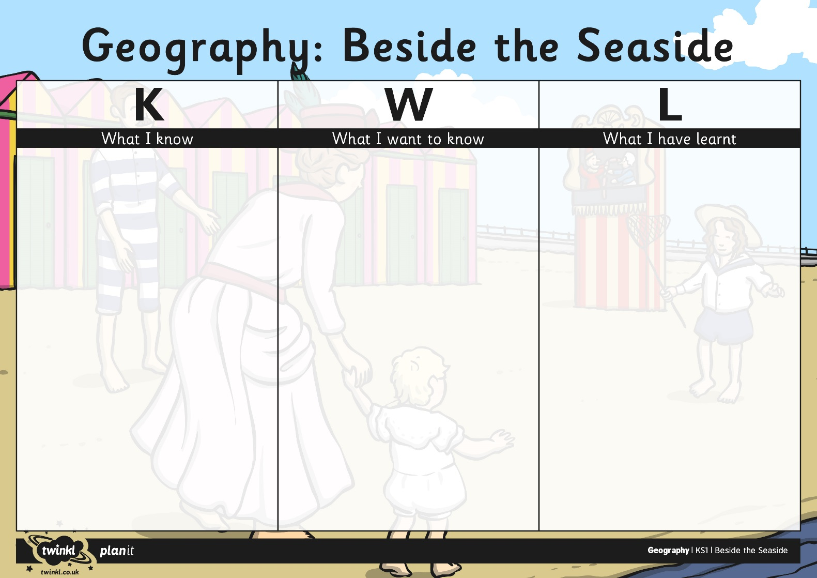
What do I Know Already?

Slide 7

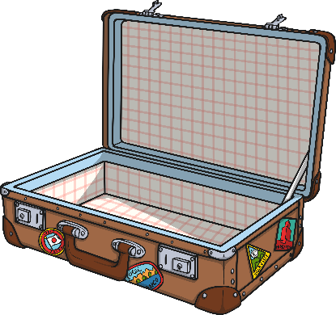
Where Have We Visited?
What different places have you visited?
Are these places nearby or far away?

Slide 8
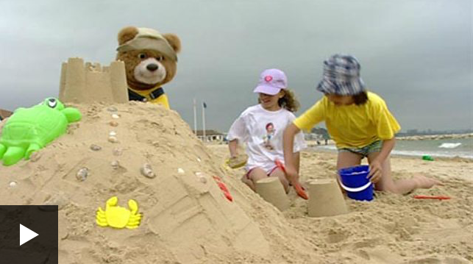
Sun, Sand and Seasides
What do we know about the seaside and what is it like?
What things can you do at a seaside resort and why do people visit them?
Click to watch the video

Slide 9
Sun, Sand and Seasides
What are the main features of the seaside?
The Seaside
The…
Notes:
Write in the text box to add children’s rersponses.

Slide 10

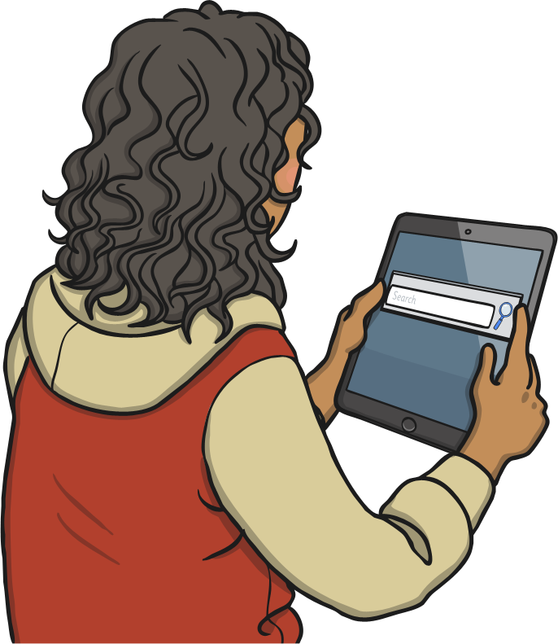

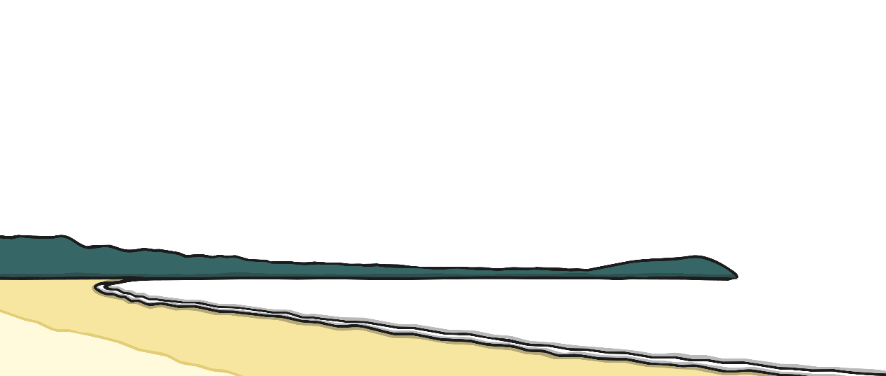
Where Is Our
Nearest Seaside?
Work together to locate (find) our local area and then our nearest seaside resort.
Where do we live?
Where is the nearest seaside resort to us?
Has anybody visited this resort?
Notes:
Write in the text box to add children’s rersponses.

Slide 11

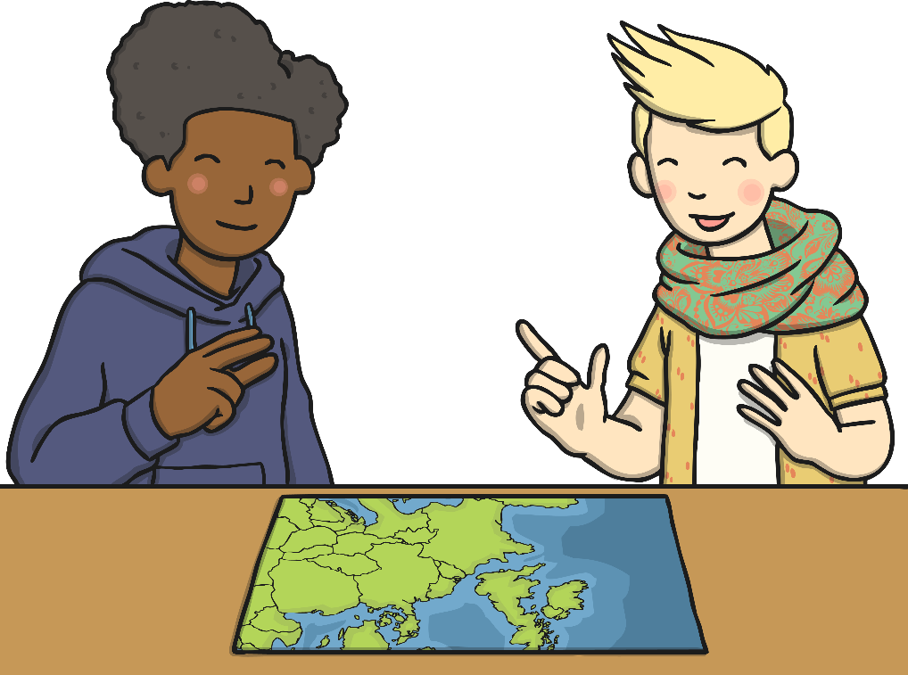
Researching Resorts
You are going to find out about a seaside resort by carrying out research in pairs or a small group. What things could you research?
You could use books, maps, leaflets, posters and the Internet to help you collect information about your seaside resort. You could present your research in many different ways.
Notes:
Write in the text box to add children’s rersponses.

Slide 12
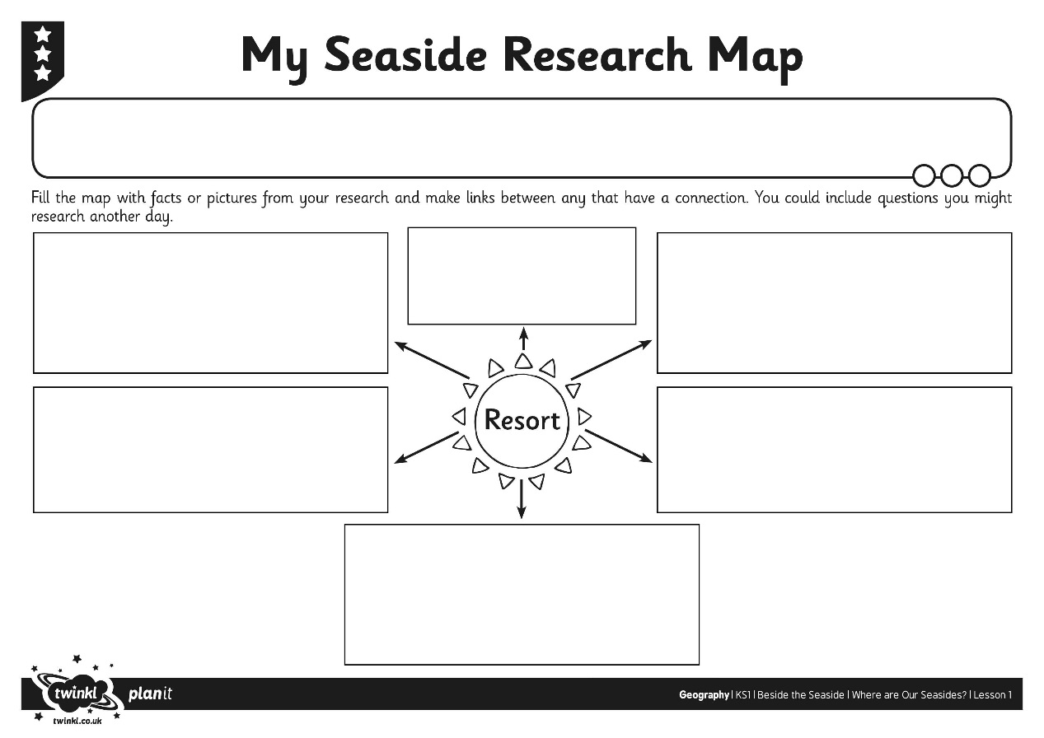
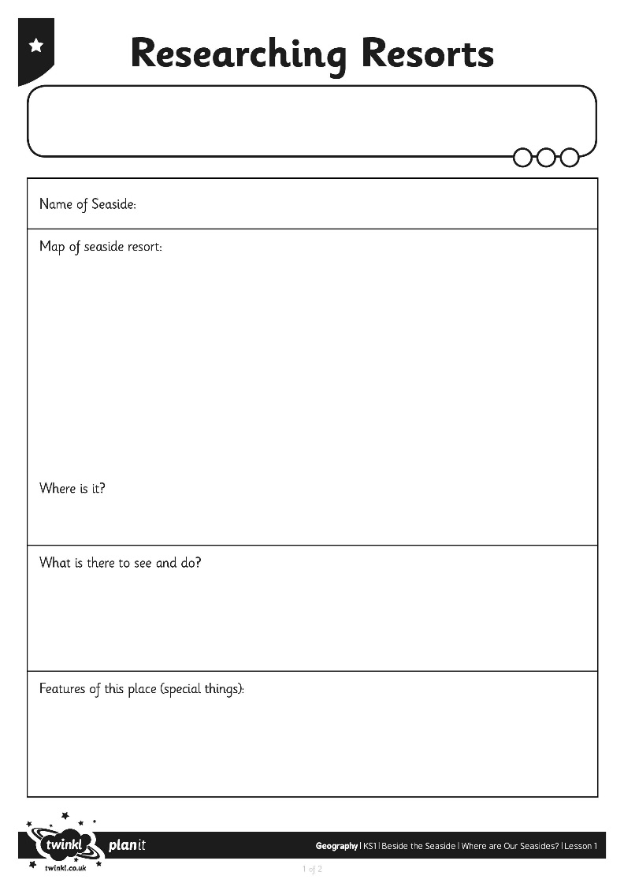
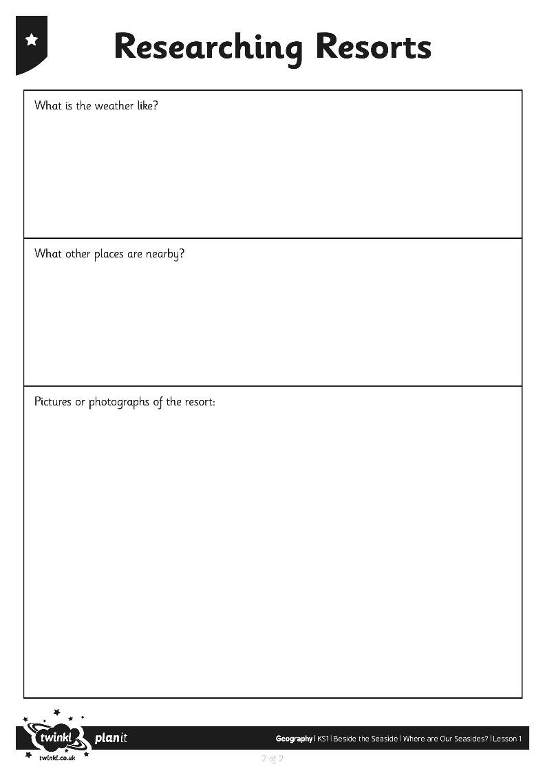
Researching Resorts
Notes:
Write in the text box to add children’s rersponses.

Slide 13
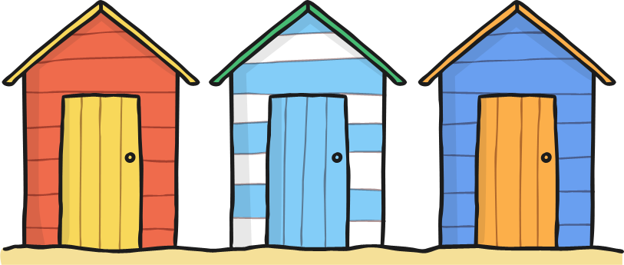
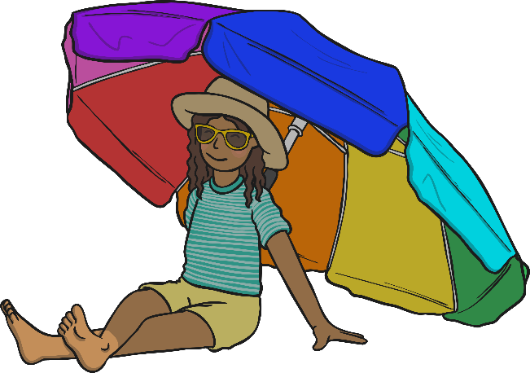

Spot the Difference
Ready, Steady, Catch!
How is the seaside different to our local area?
In what ways might it be the same?
Notes:
Write in the text box to add children’s rersponses.

Slide 14
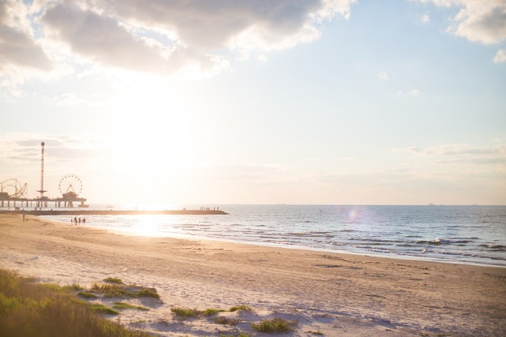
Spot the Difference
Notes:
Write in the text box to add children’s rersponses.

Slide 15
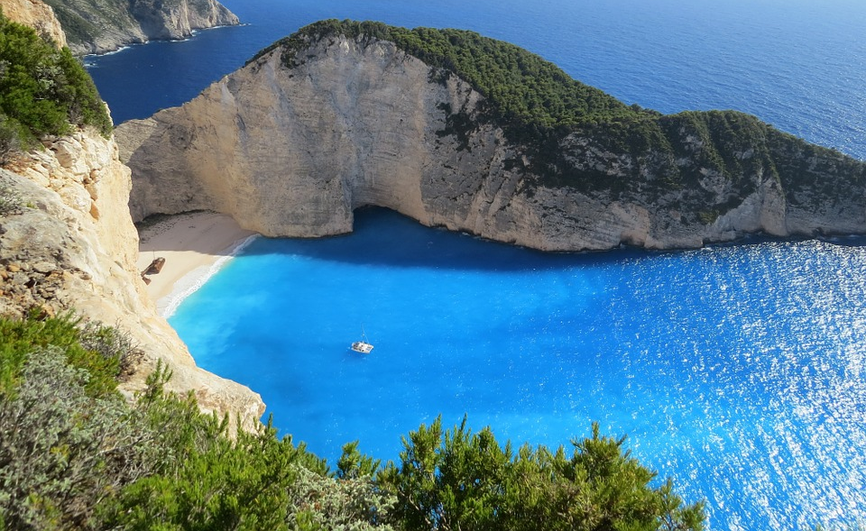
Spot the Difference
Notes:
Write in the text box to add children’s rersponses.

Slide 16
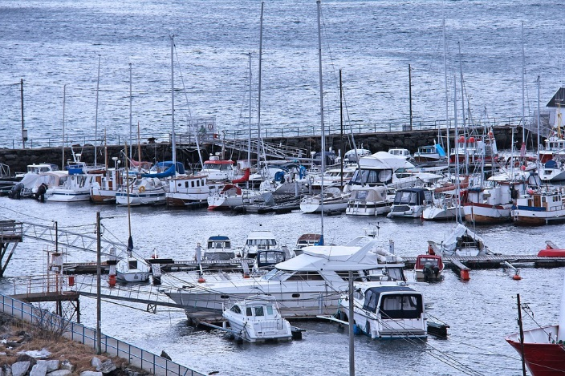
Spot the Difference
Notes:
Write in the text box to add children’s rersponses.

Slide 17

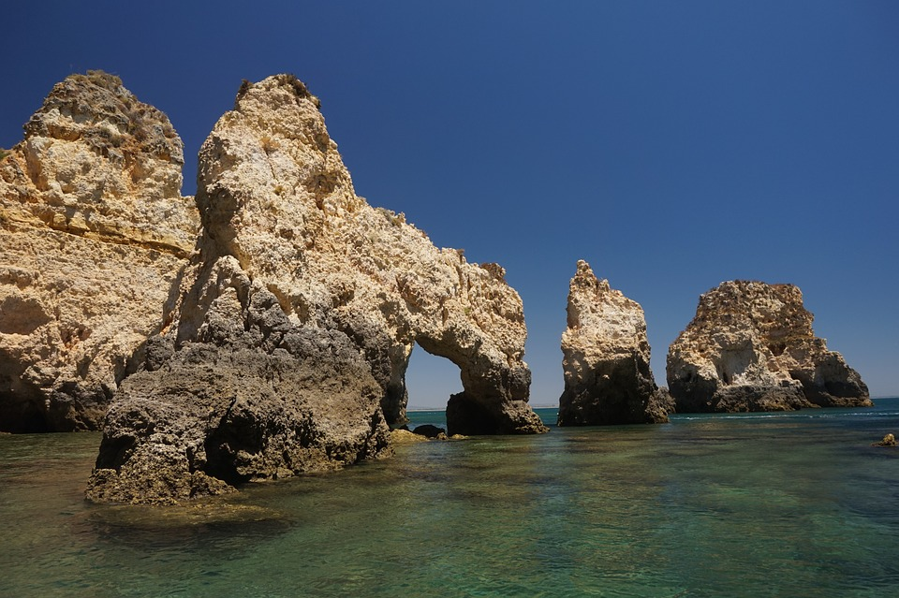
Spot the Difference
Notes:
Write in the text box to add children’s responses.

Slide 18
Aim
I can use key words to describe different places and environments.
I can use a map to find seaside locations.
Success Criteria
I can use key words to describe different places I have visited.
I can talk about the different types of environments that people can visit and describe what they are like (town, village, city, countryside, seaside).
I can use key words to describe what seaside locations are like.
I can locate (find) our nearest seaside resort on a map.
I can find out three facts about our nearest seaside resort.

