Slide 1
Monday 18th January
Maths
Ten Town – 0 and 1
Number Bonds to 6

Slide 2
Warm up
Lets get our brains and bodies warmed up for maths today. This time we are going to see if we can count to 100!
https://www.youtube.com/watch?v=1dkPouLWCyc

Slide 3
Parent information: Ten Town
For the next few weeks we are going to be looking at a different number on Ten Town each day. Ten Town will help you child practise their number formation.
You will need to visit the website; https://beta.tentown.co.uk/
Your child’s login details have been sent in the resource pack and are also on Tapestry. I have also attached an information sheet which will help you access the learning resources.
If you have any problems accessing Ten Town, please email me directly.

Slide 4
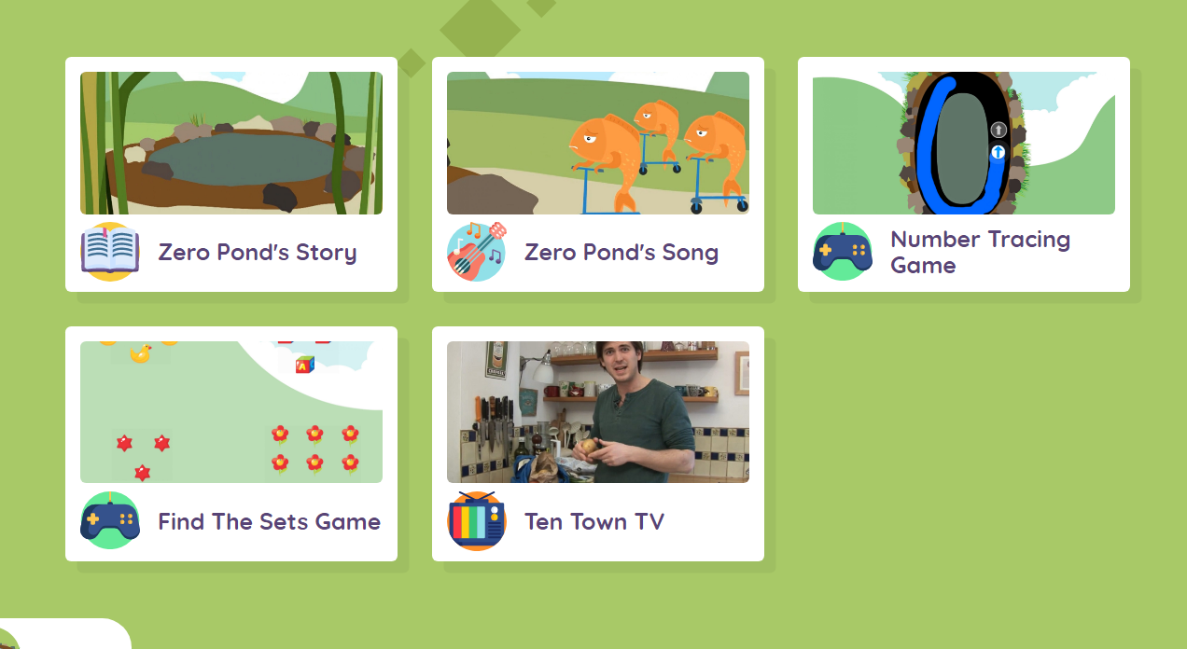
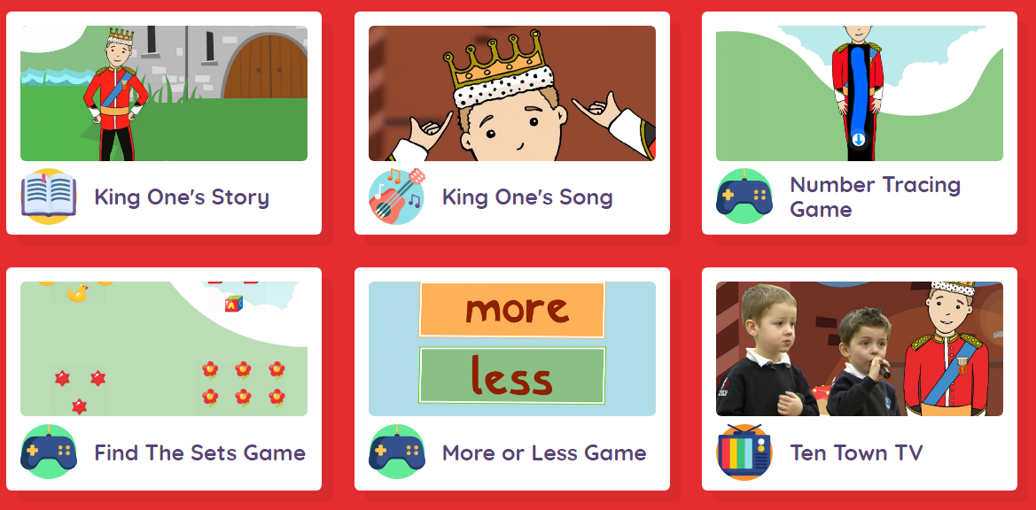
Ten Town
Today we are going to practice forming 2 of our numbers correctly.
I would like you to look at Zero Pond and King One.
Listen to each numbers story and song. You can also complete some of the other activities if you would like.

Slide 5
Number Formation
Once you have looked at the story and song for Zero Pond and King One I would like you to practise forming these numbers in your book.
I have included a video on Tapestry of forming the numbers correctly.

Slide 6
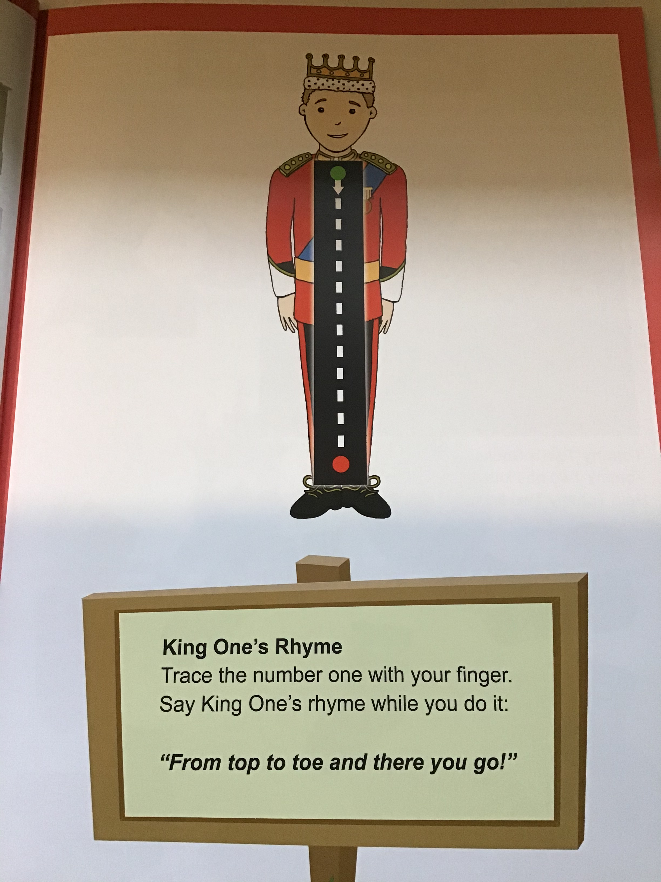

Slide 7
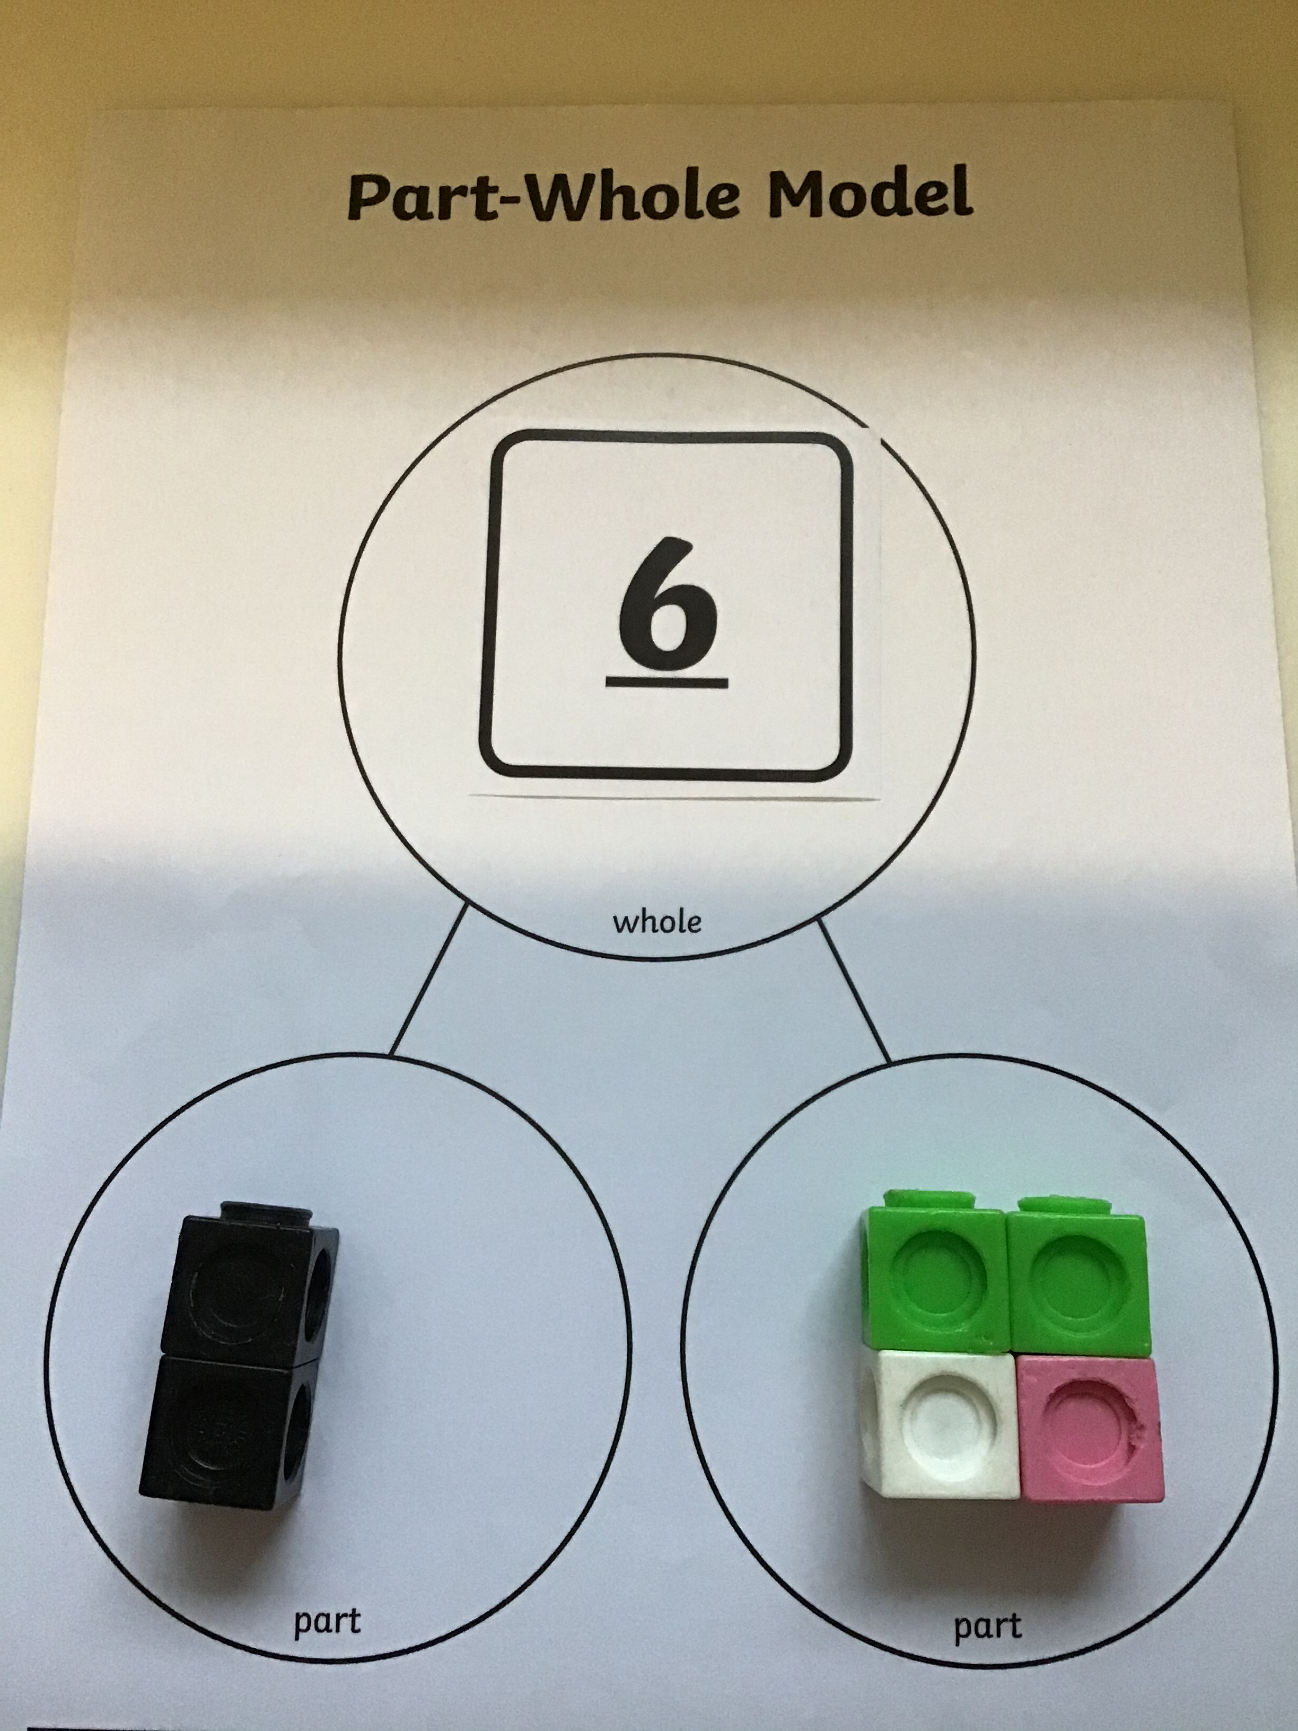
Number bonds to 6
Today I would like you to investigate all of the different ways you can make 6.
To do this you will need your part whole model and 6 small objects to use as your counters.
Explore how to make 6 in different ways. How many ways can you find?

Slide 8
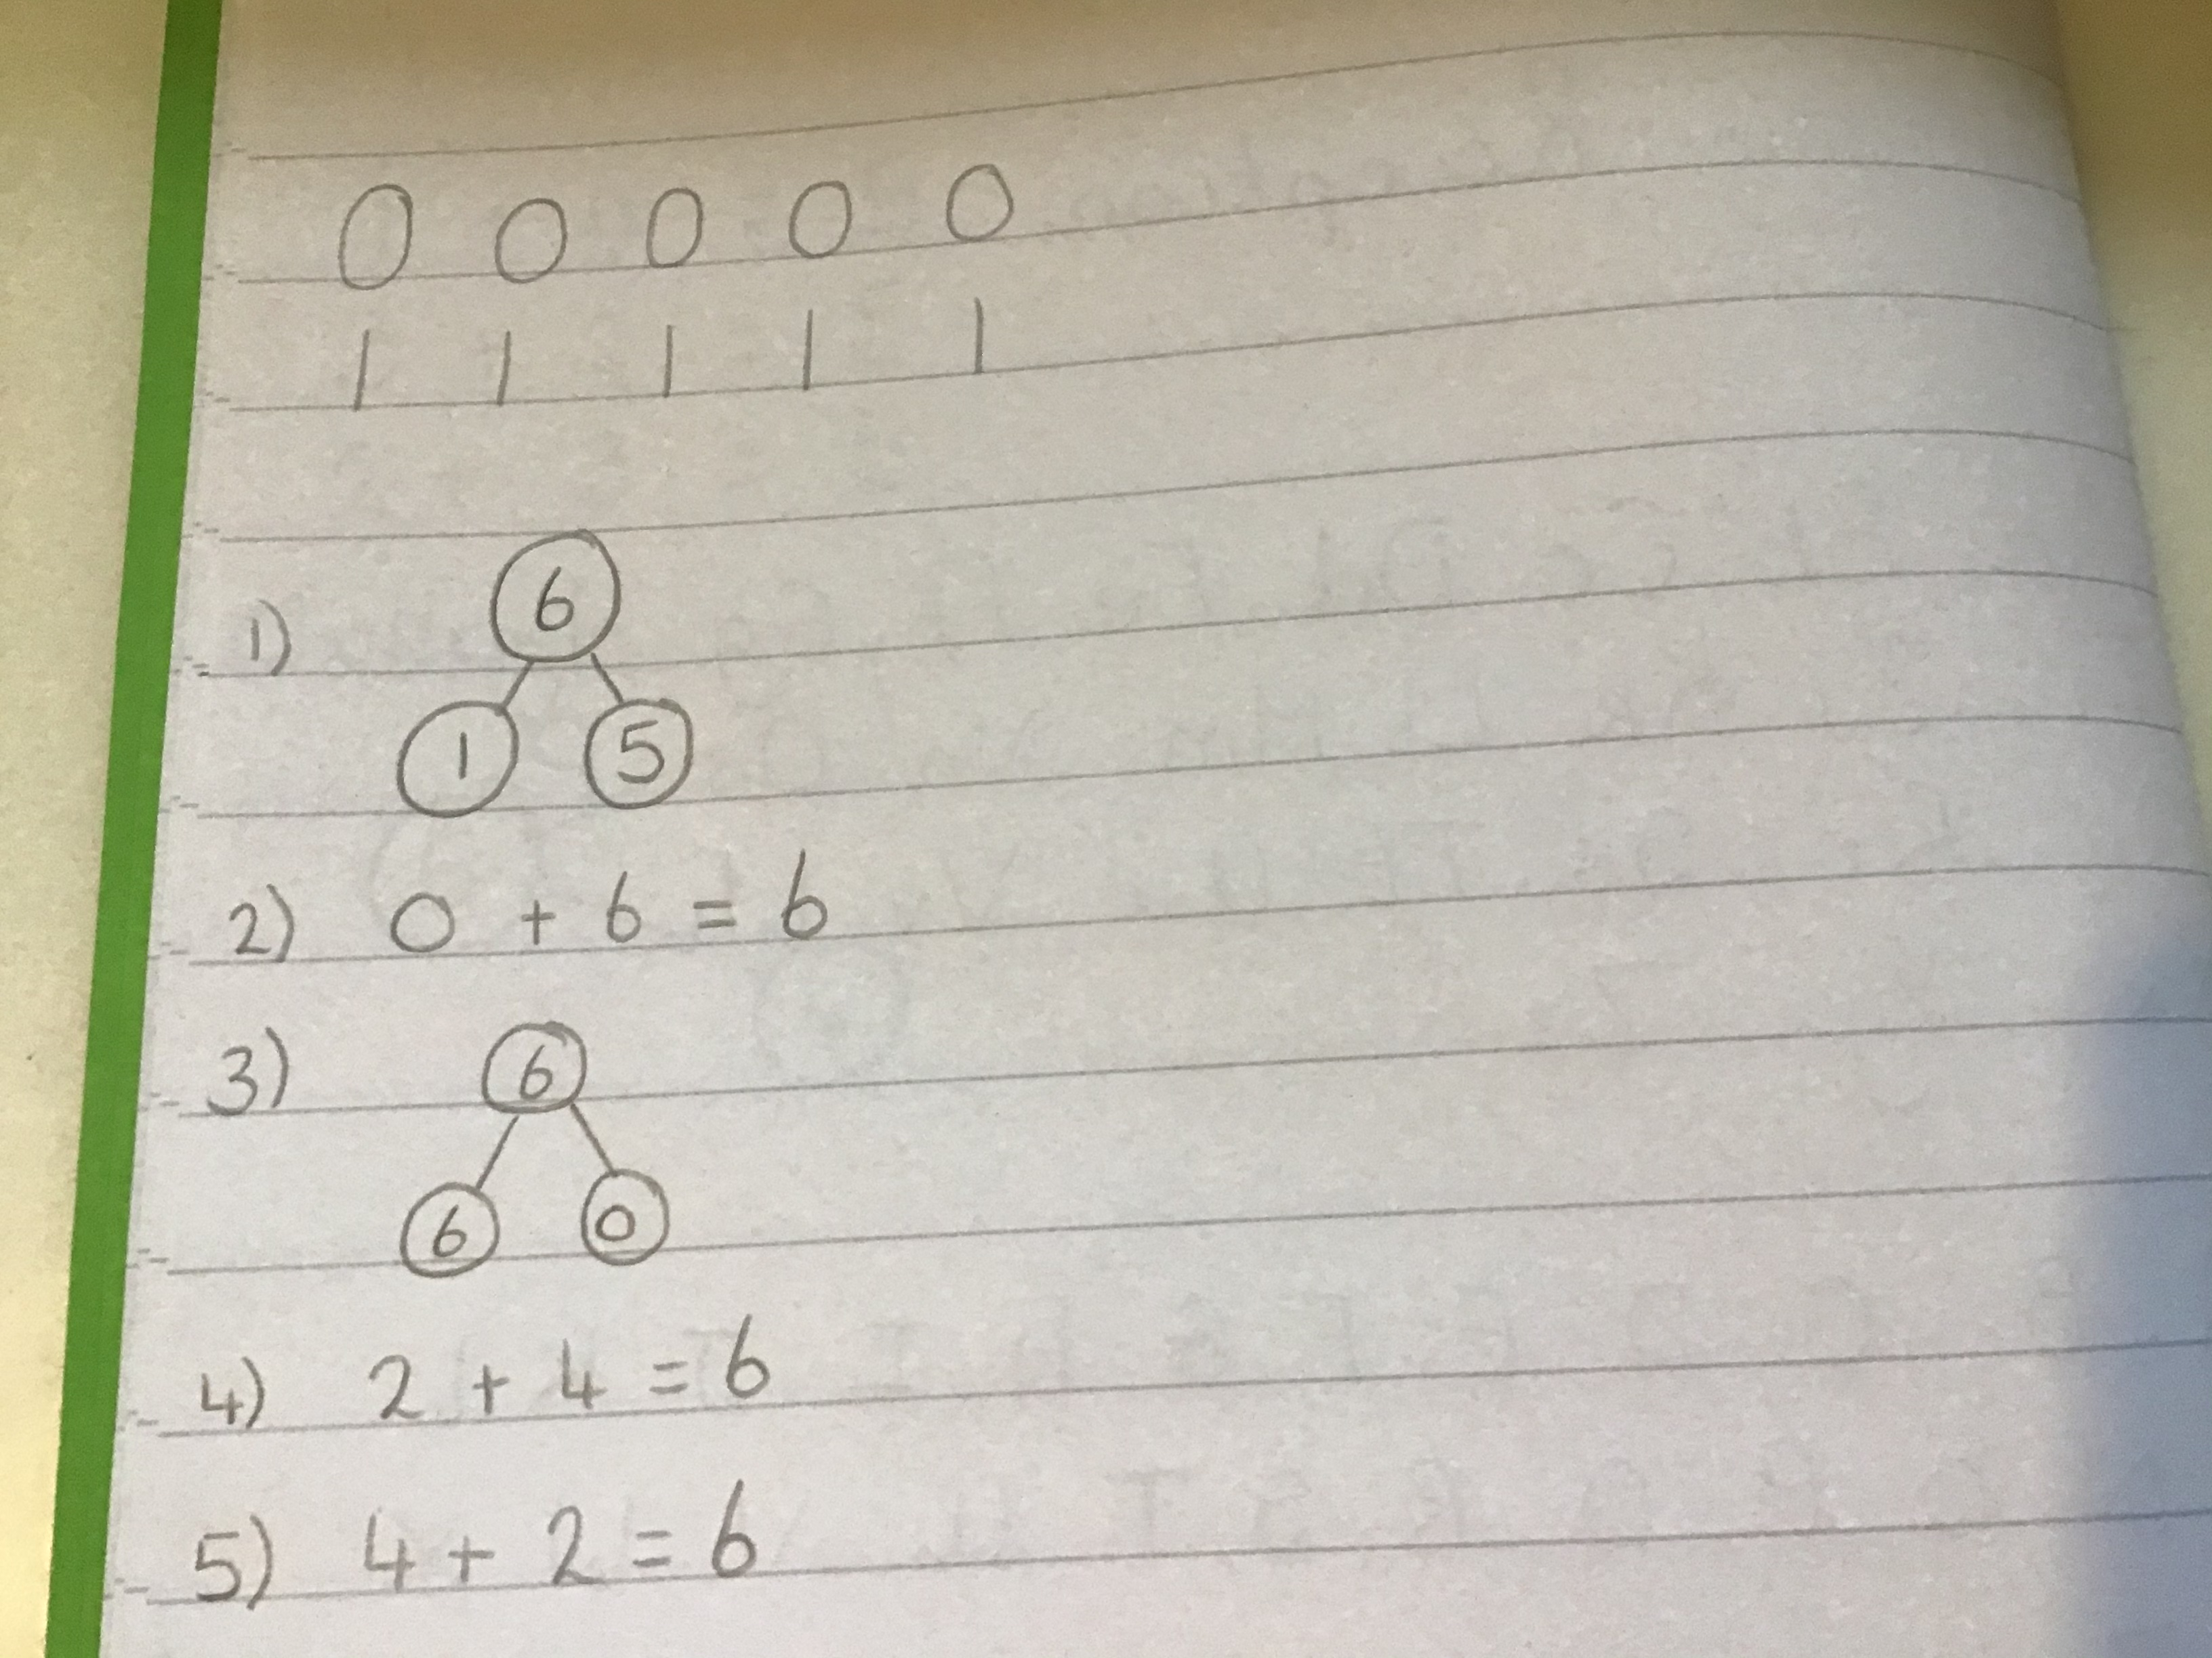
Challenge
Your challenge today is to record all of the different ways you found to make 6. You might do this through part whole models or number sentences.
I found 5 different ways. Can you find any more?

