Slide 1
PE: I have left last week’s PE on here just in case you didn’t get time to do it or you want to repeat it again!
If you can find a space somewhere in your house that would be great but remember to look carefully around you to make sure that there is nothing in your way or anything that could cause an accident!
Warm-up:
https://www.youtube.com/watch?v=d3LPrhI0v-w
Now time to dance:
https://www.youtube.com/watch?v=52pdktAMDe4
Now maybe you could listen to a piece of music you like and create your own dance moves similar to what you’ve seen in the videos!
https://www.youtube.com/watch?v=SV-Z1RMqj2Q
https://www.youtube.com/watch?v=41SkJVsm7Os

Slide 2
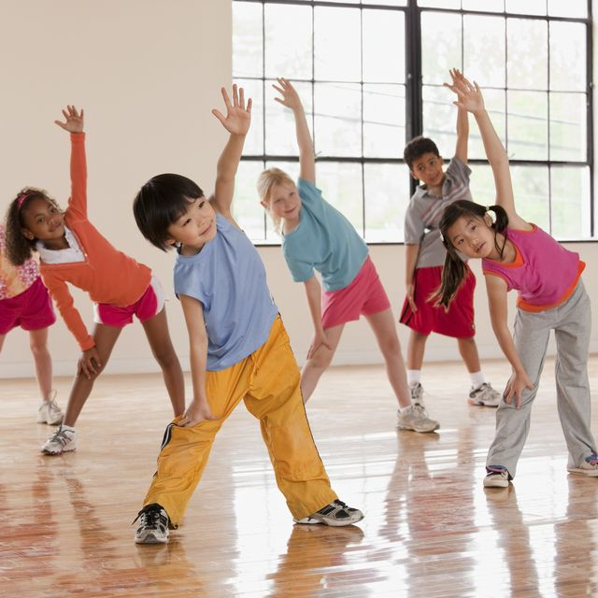
Remember to find a space to do your physical activity.
If there is anything you are finding tricky, you can march on the spot until the exercise changes! If you wanted, you could mute the video and put on some of your own music to enjoy your exercise!
Today’s workout:
https://www.youtube.com/watch?v=jUkUIAbAwOs

