Slide 1
15.1.21
WALT: Understand Area.
Here’s the video link for today’s lesson if you want to use this as well as the slides!
https://vimeo.com/499229510

Slide 3

What is a 2-D shape?
What is a 3-D shape?
Name these 2-D shapes.
What do these symbols mean?
$>$
  $=$
  $<$

Slide 4
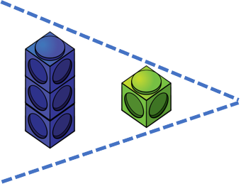

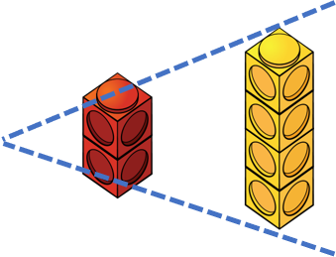
What is a 2-D shape?
What is a 3-D shape?
Name these 2-D shapes.
What do these symbols mean?
$>$
  $=$
  $<$
equilateral
isoceles
triangle
triangle
rectangle
circle
square
greater than
equal to
less than

Slide 6
These shapes have the same area.
4 squares

Slide 7
What is area?
Area is the amount of space taken up by the 2D shape.

Slide 8
Can you visualise the areas of these shapes?
Area is the space taken up by a closed 2D shape.
Area is the space taken up by a 2D shape.

Slide 9


How can we find the area of this shape?
We could fill the space with something and count how many fit inside.
The area is 14
But what about all those gaps.

Slide 10
How can we find the area of this shape?
We could fill the space with something and count how many fit inside.
That’s better! So the area is 12
The area is 14
Why don’t we try a different shape?

Slide 11






Who do you agree with?
Why are the others incorrect?
The area is 12
The area is 11
The area is 20
Have a think

Slide 12



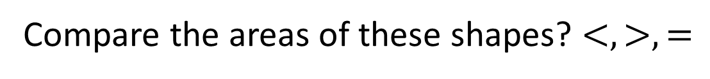
Compare the areas of these shapes? $<, >, =$
$$<$$
$$>$$
$$=$$

Slide 13


Compare the areas of these shapes? $<, >, =$
$$<$$
Draw a shape with a smaller area and
another with a larger area?
Have a think
$$>$$
$$<$$
$$=$$
$$<$$

Slide 14
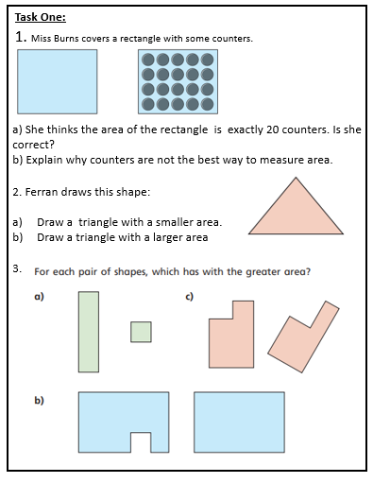

Slide 15
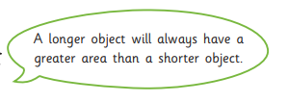
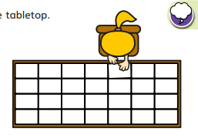
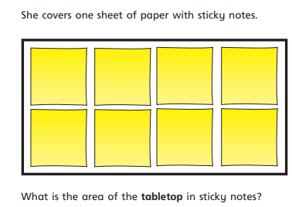
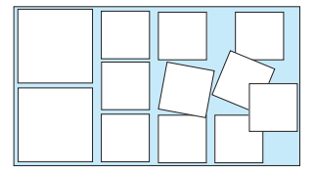
4. Miss Fitzgerald says:
Do you agree with her?
Draw a picture to support your answer.
5. Evie is measuring the area of the tabletop. She has covered the table with exactly 28 sheets of paper.
6. Mr Booth thinks the area of the rectangle is 12 squares.
Is Mr Booth correct?
How do you know?

Slide 16


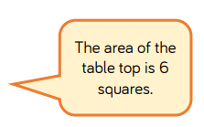
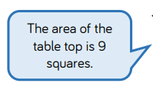

Use Your Head:
Mr Booth and Miss Burns have measured the top of their desk. They used different sized squares.
Who used the larger squares?
How do you know?
Further investigation:
What else can you find out about area? Why is it important that we know how to calculate the area of something?
Are there certain jobs where calculating area is crucial to doing their job?

